Slide 1
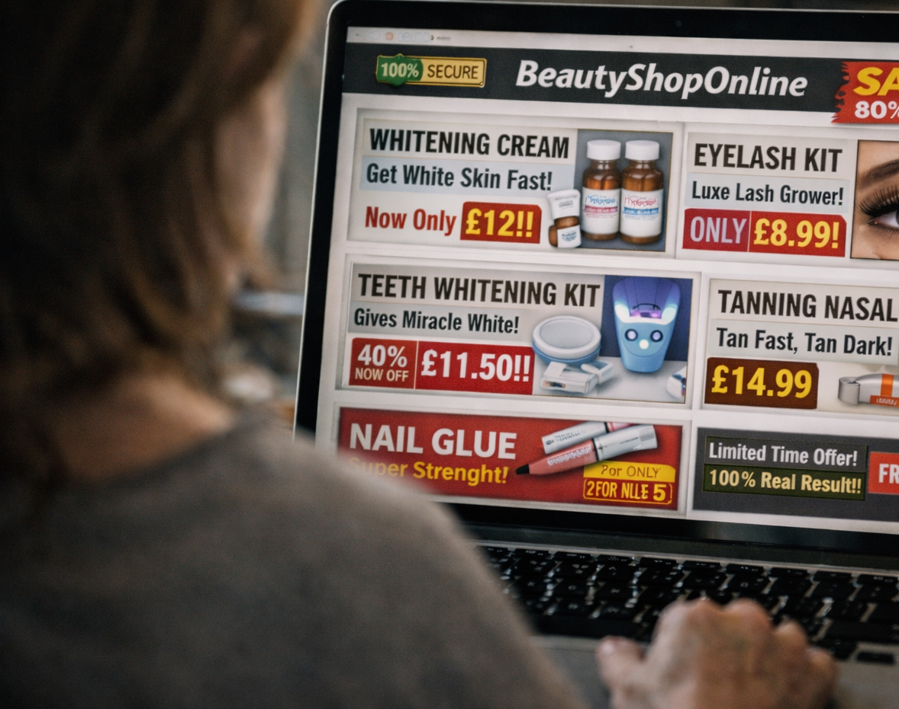
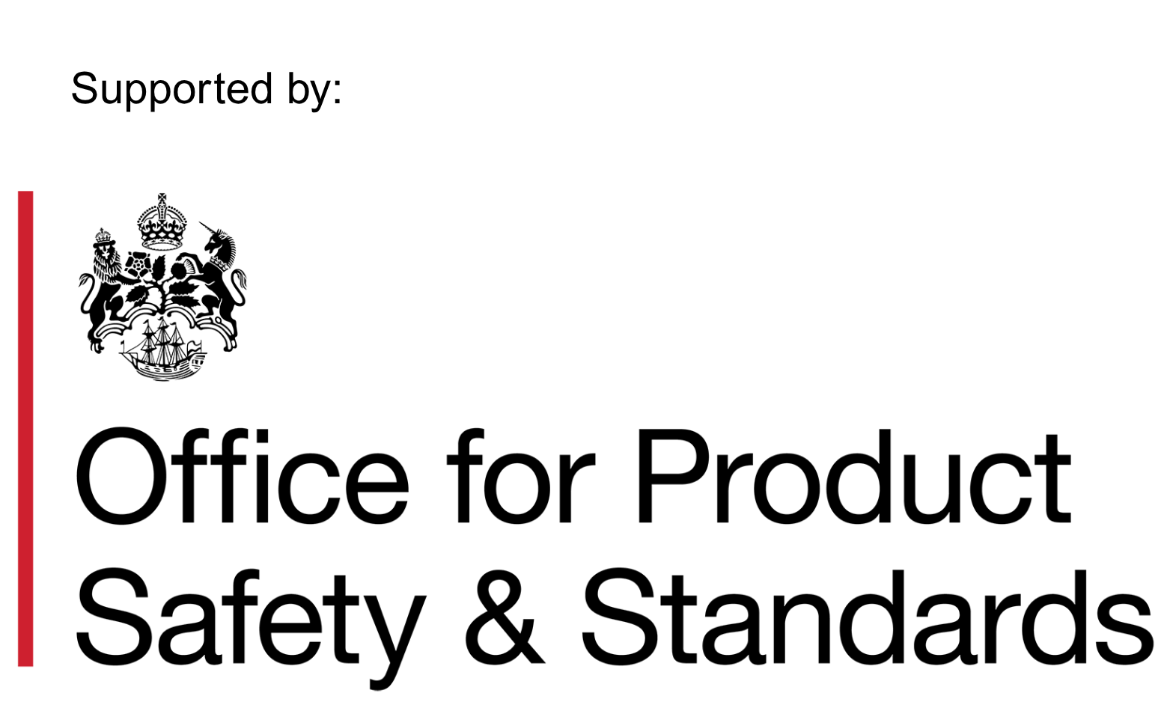
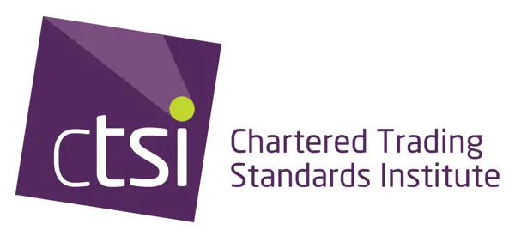
1
Chartered Trading
Standards Institute
Cost of Beauty Toolkit: Guidance

Slide 2
2
Thank you for joining the campaign!
Thank you for joining the Chartered Trading Standards Institute (CTSI) Cost of Beauty campaign.
Inside this toolkit you will find practical resources and clear guidance designed to help educate consumers about the dangers of counterfeit and unsafe cosmetic products and treatments.
This toolkit equips educators, community leaders, and enforcement officers with materials they can use confidently in community settings, schools, workplaces, and local campaigns. It focuses on everyday products that are widely available online and through informal sellers, including skin lightening creams, eyelash and nail kits, teeth whitening products, and tanning sprays. The resources explain how these products can cause burns, infections, allergic reactions, and longer term health harm, and why poor labelling, false claims, and illegal ingredients are common warning signs.
The content is designed to be accessible and adaptable, supporting straightforward conversations about consumer rights, product safety, and the risks of buying unregulated beauty products. It also helps reinforce the message that professional treatments should be carried out by trained practitioners using products that meet UK safety requirements.
Thank you once again for downloading the toolkit.
From the CTSI Policy Team: policy@tsi.org.uk
Contents:
About the Campaign
Core Educations Material
Myth Busting & Common FAQs
Visual & Digital Assets
Delivery Guidance
Resource Directory
#CostofBeauty

Slide 3
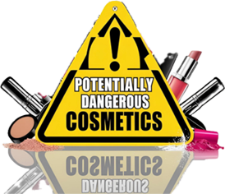
About the campaign and key messages
3

Slide 4
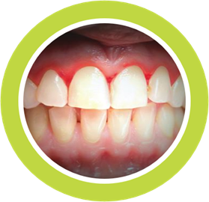
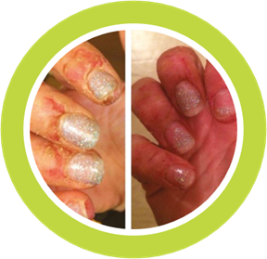
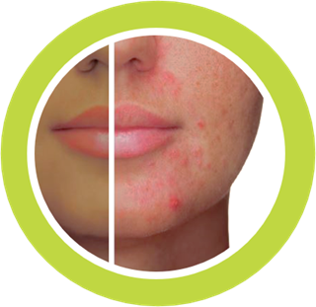
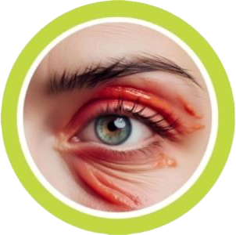
4
About the Campaign
The Cost of Beauty campaign is led by the Chartered Trading Standards Institute (CTSI) in partnership with the Office for Product Safety and Standards (OPSS).
The campaign began in 2024 to highlight the real harm caused by unsafe and illegal cosmetic products and treatments. Early campaign activity focused on products commonly sold online and used at home, including UV gel and L&P nail kits, illegal skin lightening creams and unregulated teeth whitening products. Evidence from Trading Standards services showed these products were linked to chemical burns, allergic reactions, eye injuries and long term skin damage.
In 2025 the campaign was refreshed to reflect emerging risks seen by enforcement officers and reported by consumers. The updated focus includes at home lash lift and tint kits, strong nail adhesives and nasal tanning sprays, all of which are widely available online but often sold without proper safety information or regulatory compliance. The campaign continues to challenge the assumption that low cost or easy access means low risk.

Slide 5
5
Campaign Goal and Key Messages
The aim of this campaign is to raise awareness that beauty products bought online or used at home can pose serious health risks when they are unregulated or used without professional training. Many products are promoted as cheap, quick alternatives to salon treatments, but are sold without proper safety checks or clear instructions.
This matters because unsafe beauty products can cause real and lasting harm. Eyelash kits and nail adhesives can lead to chemical burns and eye injuries. Nasal tanning sprays can irritate the airways and introduce unknown substances into the body. Skin lightening creams are frequently linked to mercury or high strength steroids, which can damage the skin and affect wider health. These risks are often not obvious at the point of sale, leaving consumers exposed to harm they did not anticipate.
KEY MESSAGE 1
KEY MESSAGE 2
KEY MESSAGE 3
Beauty treatment should be carried out by a trained practitioner.
Only purchase products from verified reputable sources. If it’s too good to be true, it’s not.
Just because it is for sale, it doesn’t mean it’s safe.

Slide 6
6
Why unsafe cosmetic products are a concern
Unsafe beauty products can affect people of all ages and backgrounds. Young people are particularly exposed due to trends promoted on social media and the normalisation of at home cosmetic treatments.
Harm linked to unsafe products includes:
Chemical burns to skin and eyes
Infections caused by poor hygiene or contaminated products
Severe allergic reactions
Longer term skin damage and scarring
In some cases, injuries are permanent and require medical treatment. These harms are preventable when products meet safety standards and treatments are carried out by trained professionals.

Slide 7
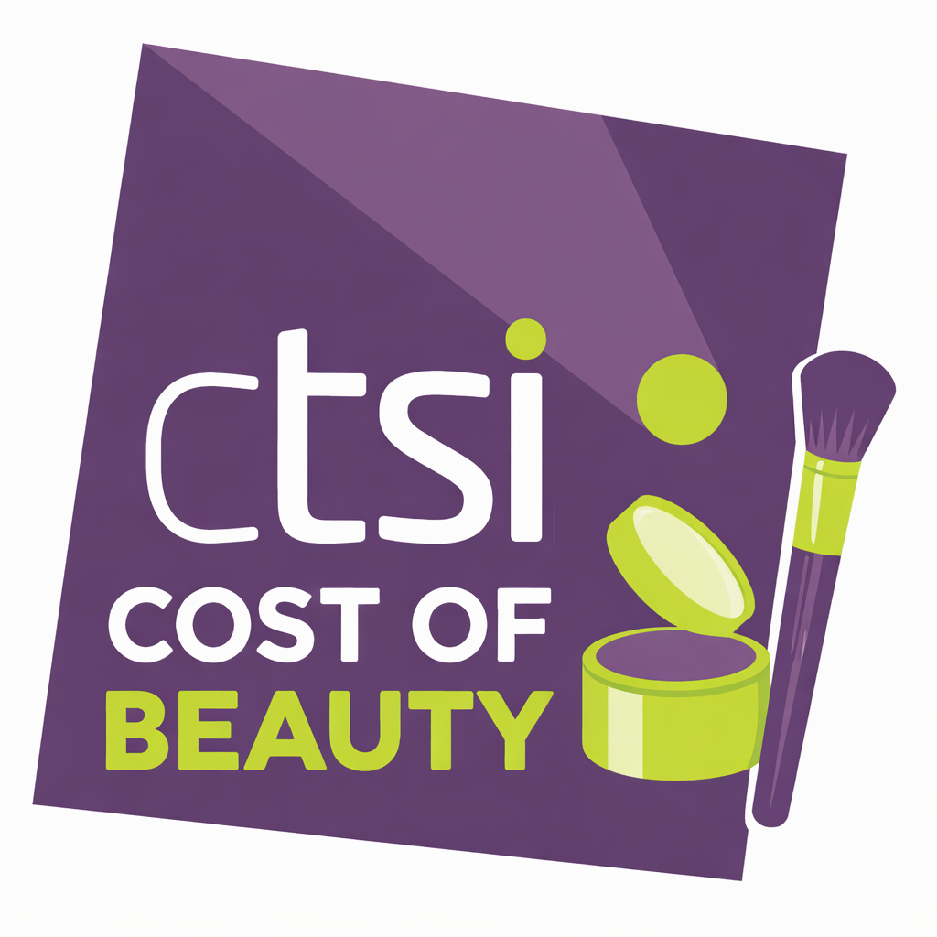
7
Benefits of supporting the campaign
The Cost of Beauty campaign supports organisations in raising awareness of the real and often hidden risks linked to unsafe and unregulated beauty products sold online or used at home, helping to protect consumers from avoidable harm.
By supporting the campaign, partners can strengthen consumer education activity and build confidence in discussing product safety, online purchasing risks and the impact of social media trends.
Campaign resources are designed to be flexible, making them suitable for use alongside existing education, outreach, health or enforcement work, including sessions with young people and community groups.
Supporting Cost of Beauty also reinforces the role of Trading Standards and partner organisations in promoting compliance, tackling illegal products and protecting public health.

Slide 8
Thank you!
31
For additional guidance and questions, please contact the CTSI Policy Team at: policy@tsi.org.uk

