Slide 1
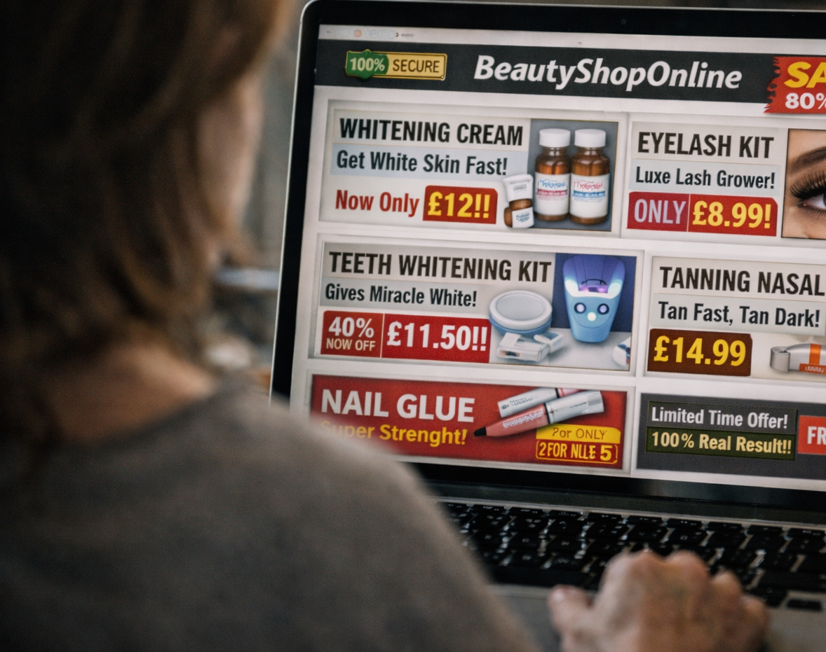


Chartered Trading
Standards Institute
Cost of Beauty Toolkit: Myths & Digital Assets

Slide 2

Myth Busting & Common FAQs

Slide 3
Common Myths
A key part of consumer education is addressing common myths about beauty products sold online or used at home. Many consumers assume that products are safe because they are widely available, heavily promoted or recommended by others online. Social media trends, influencer marketing and online marketplaces can normalise risky products and treatments, making them appear routine and low risk.
Challenging these assumptions helps consumers better understand how safety standards work, why some products are illegal or unregulated, and how harm can occur even when risks are not immediately obvious.
Myth: At home kits are weaker than salon treatments
Fact Many contain chemicals intended for trained professionals and can cause serious injury if misused.
Myth: Natural or herbal products are always safe
Fact Natural ingredients can still cause burns, irritation or allergic reactions.
Myth: Professional looking packaging means the product is legitimate
Fact Unsafe and illegal products are often designed to look convincing and compliant.
Myth: If lots of people use it, it cannot be dangerous
Fact Harm may develop over time or affect some users more severely than others.
Myth: If it is sold online, it must be safe
Fact Online marketplaces do not guarantee that products meet UK safety or legal requirements.

Slide 4

Common FAQs
1. Question: Are small amounts of hydrogen peroxide safe to use at home?
Answer: No. Even low concentrations can cause chemical burns, eye injuries and allergic reactions if applied incorrectly or without appropriate training. Products containing hydrogen peroxide are intended for controlled use, often by trained professionals, and misuse can lead to permanent damage.
2. Question: Why are these products allowed to be sold if they are unsafe?
Answer: Some products are sold illegally or without proper checks, particularly through online marketplaces and social media sellers. Availability does not mean a product meets UK safety or legal requirements.
3. Question: What should consumers look out for when buying beauty products online?
Answer: Warning signs include missing or unclear ingredient lists, poor instructions, exaggerated claims, very low prices and sellers based outside the UK. These can indicate that a product has not been assessed for safety.
Encouraging questions during sessions helps audiences engage more confidently and supports better understanding of how harm can occur and how it can be avoided.

Slide 5



Visual and Digital Assets and Engagement Tools

Slide 6
Visual & Digital Assets
Visual and digital assets help communicate safety messages quickly and clearly, particularly for audiences who may not engage fully with written guidance. They are useful for starting conversations, reinforcing key points and supporting discussion during sessions.
The assets within this toolkit can be used during workshops, shared online, or displayed in public settings to extend reach beyond face-to-face activity.
The toolkit includes:
Social media templates for sharing consistent Cost of Beauty messages online. Any social media activity should use the campaign hashtag #CostofBeauty.
Short videos to introduce risks and explain safer practice.
Posters and infographics for use in schools, salons and community venues.
Visual materials help make risks easier to recognise and remember, especially where unsafe products are promoted through images and short form video.
Visual & Digital assets can be found in the ‘Social Media Content’ folder

Slide 7
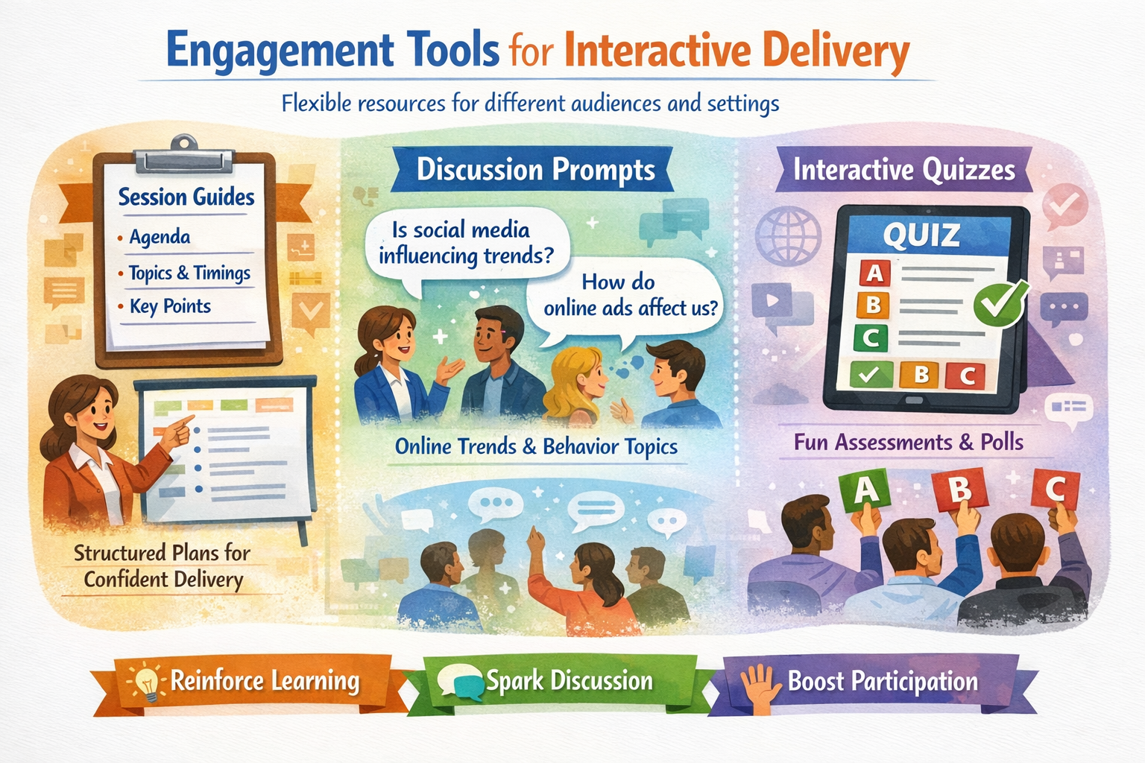
Engagement Tools
To support interactive delivery, the toolkit includes a range of engagement tools that can be used flexibly across different audiences and settings.
These include:
Session guides with suggested structures, timings and key talking points to support confident delivery
Discussion prompts focused on online trends, social media influence and consumer behaviour
Quizzes to assess understanding before and after sessions and encourage audience participation
These tools help reinforce learning, prompt discussion and support meaningful engagement rather than one way information delivery.
Engagement tools can be found in the ‘Community & Education’ folder.

Slide 8
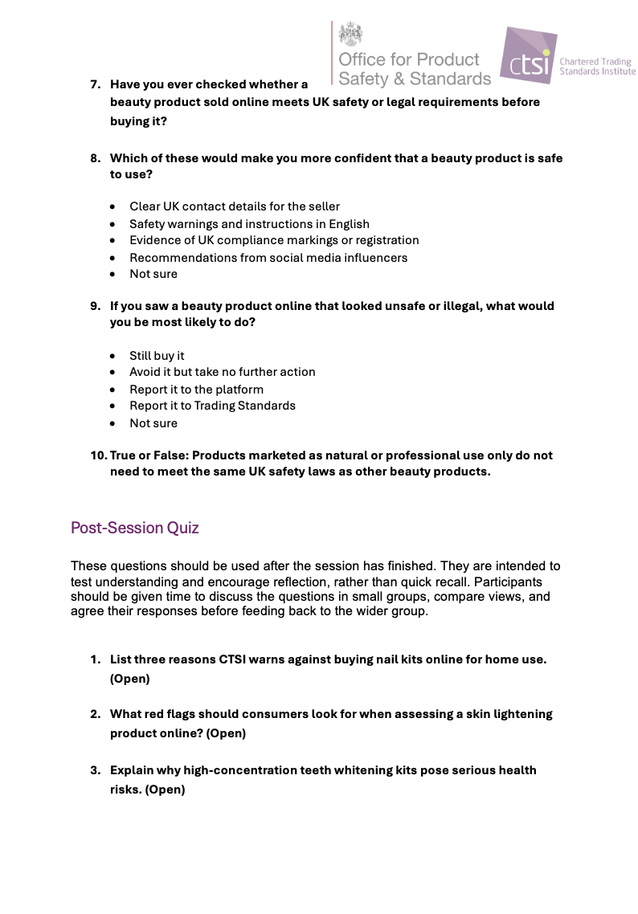
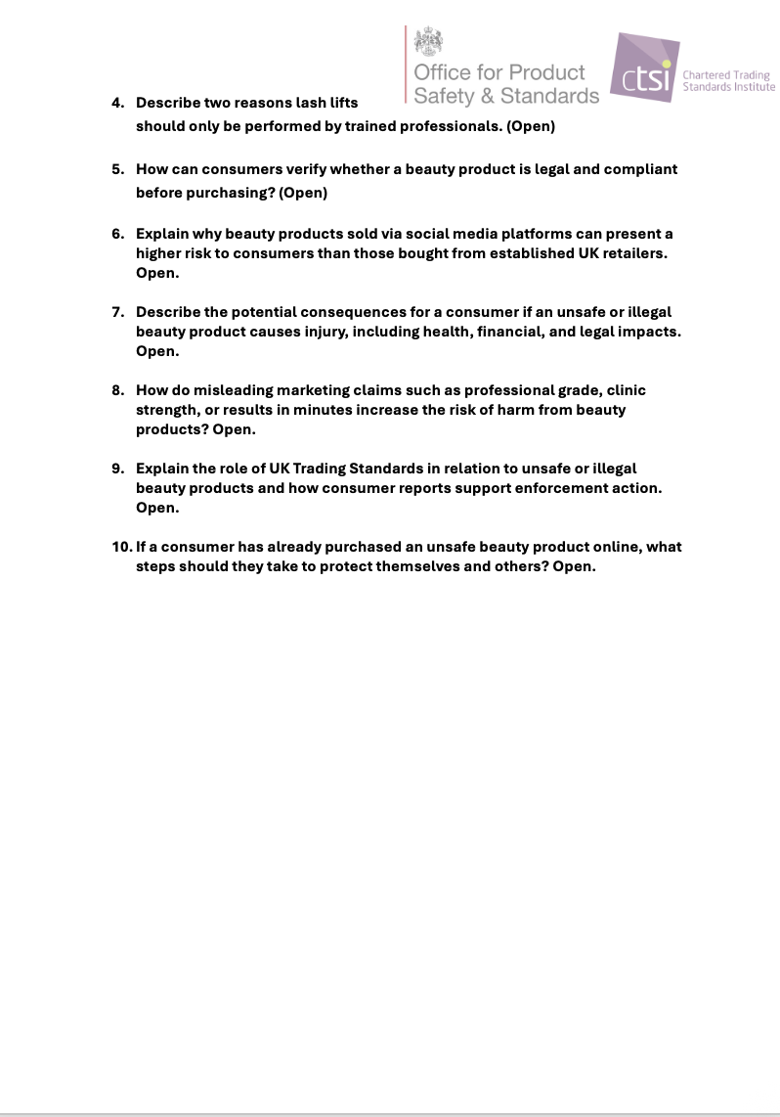
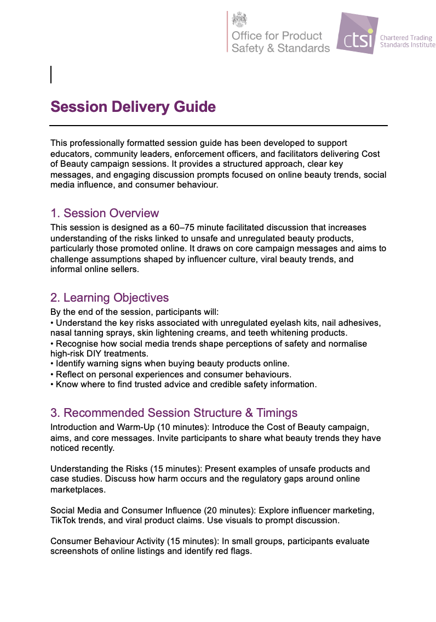
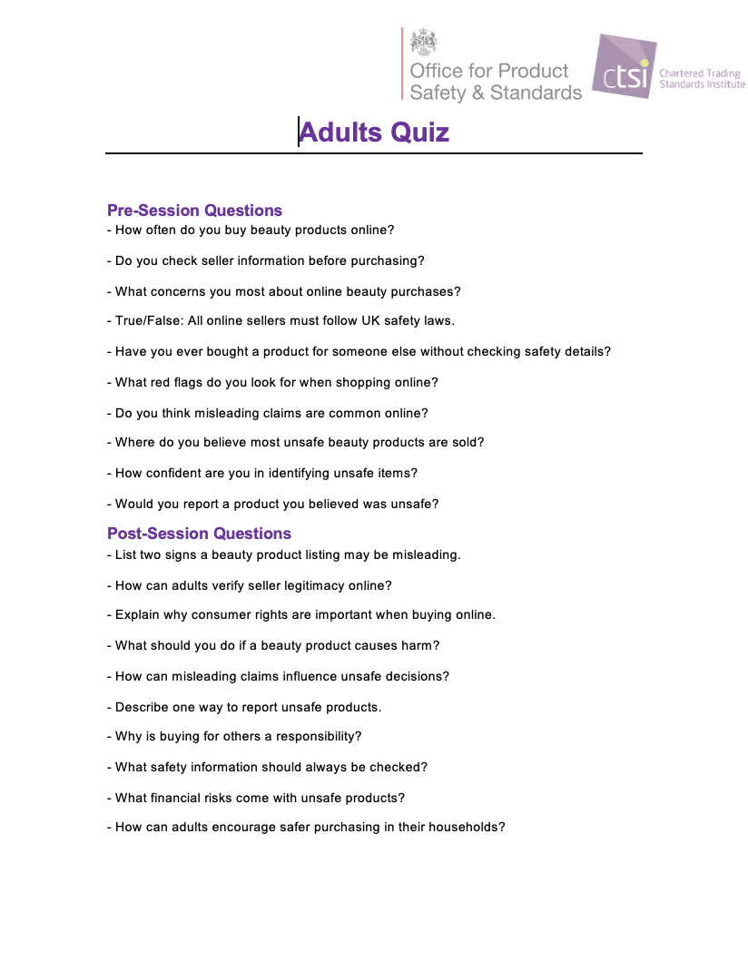
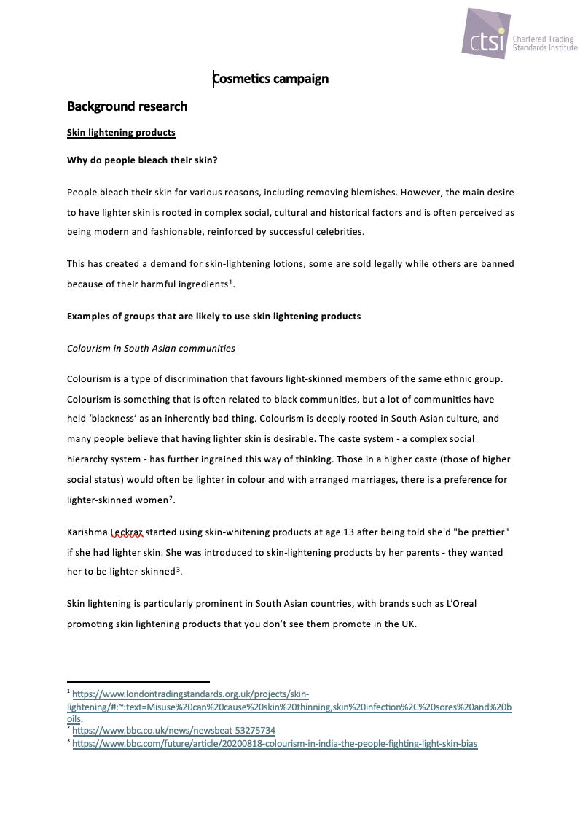
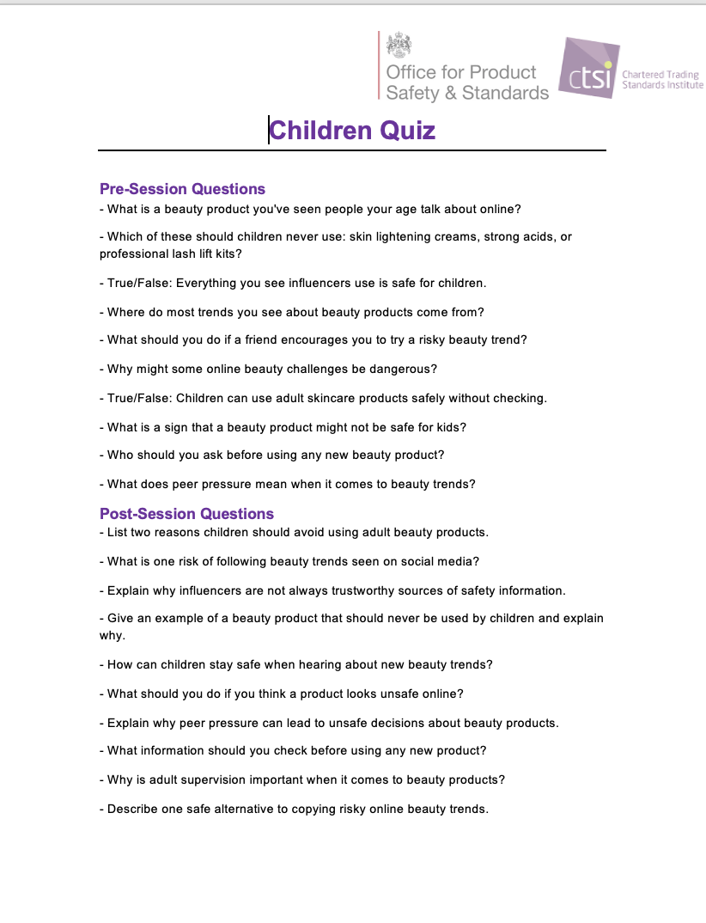
Community & Education Folder Guide
The Community and Education folder brings together resources to support local engagement, awareness sessions and educational activity. Within this folder, the Quiz examples subfolder contains a set of sample quizzes linked to the campaign. These are provided as guidance only and can be adapted, shortened or reworked to suit different audiences, settings and time available.
The quiz examples are broken down into categories based on age groups, general consumers, and professionals, allowing sessions to be tailored to the audience.
The folder also includes supporting materials such as consumer safety tips, images of real life products to prompt discussion, and a session delivery guide to support structured delivery. All content is intended to be used flexibly alongside the wider Cost of Beauty campaign materials.
Notes:
Screenshot 2026-01-20 at 13.26.46

Slide 9
Example Social Media Posts
Don’t forget to tag us in your posts so we can share them!
LinkedIn ; Facebook; Instagram (@ctsi_headoffice); X (formally Twitter) (@CTSI_UK)
Facebook:
Just because a beauty product is for sale online does not mean it is safe. Unregulated eyelash kits, nail adhesives and skin lightening creams can cause serious harm, including burns and allergic reactions.
Find out how to spot unsafe products and protect yourself: www.tradingstandards.uk/news-policy-campaigns/campaigns/cost-of-beauty-2025/
#CostofBeauty
Instagram:
Trending beauty products are not always safe.
Many at home kits sold online bypass UK safety checks and can cause lasting damage.
Think before you buy and know the risks.
#CostofBeauty
LinkedIn
Unsafe and unregulated beauty products continue to reach consumers through online marketplaces and social media. The Cost of Beauty campaign highlights the real risks and the role of regulation in protecting public safety.
Learn more and help raise awareness. Read more at: www.tradingstandards.uk/news-policy-campaigns/campaigns/cost-of-beauty-2025/
#CostofBeauty
Additional examples can be found in the ‘Social Media Content’ folder within the Toolkit

Slide 10
Example Website and Newsletter
The Cost of Beauty campaign highlights the growing risks linked to unsafe and unregulated beauty products sold online or used at home. Many of these products are widely promoted through social media and online marketplaces, giving consumers the impression that they are safe and legitimate when they are not.
The campaign supports consumers, educators and communities to better understand the hidden harms behind these products, including chemical burns, infections, allergic reactions and long term skin or eye damage. It also explains why professional standards, product safety checks and enforcement are essential to protecting public health.
Cost of Beauty focuses on products commonly found online, such as eyelash lift kits, nail adhesives, skin lightening creams and nasal tanning sprays, which may bypass UK safety requirements or contain illegal ingredients.
Through practical guidance, real case studies and clear messaging, the campaign aims to challenge common myths, raise awareness of warning signs and support safer consumer choices.
To learn more about the risks and how to protect yourself and others, visit the Cost of Beauty campaign website and access free consumer education resources.

Slide 11
Thank you!
For additional guidance and questions, please contact the CTSI Policy Team at: policy@tsi.org.uk

