Slide 1
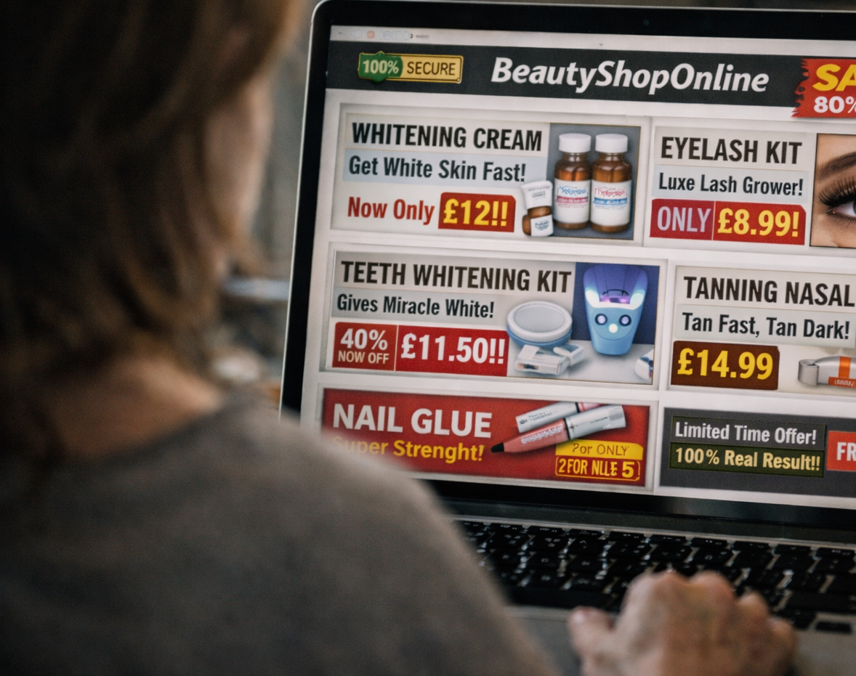


Chartered Trading
Standards Institute
Cost of Beauty Toolkit: Delivery Guidance

Slide 2

Session Delivery Guidance

Slide 3
Delivery Guidance
When delivering Cost of Beauty sessions, use a clear and structured approach while adapting content to the audience and setting.
Key steps include:
• Begin by introducing the Cost of Beauty campaign and its focus on unsafe and unregulated beauty products sold online or used at home.
• Clearly set out the three core messages that being for sale does not mean a product is safe, and that treatments should be carried out by trained professionals.
• Select relevant factsheets and visuals that reflect current trends or products familiar to the audience.
• Use real examples and enforcement case studies to show how harm occurs and why safety rules exist.
• Encourage discussion around social media trends, online marketing and personal experiences with beauty products.
• Challenge common myths calmly and factually, using the myth busting materials provided.
• Close by signposting to trusted advice, including Trading Standards and the Cost of Beauty campaign resources.
Sessions should be delivered in a clear, supportive and non-judgmental way. The aim of the Cost of Beauty campaign is to raise awareness and support safer choices, not to blame consumers for past behaviors.
The Session Delivery Guide can be found in the ‘Community & Education’ folder.

Slide 4

Evaluation and Feedback
Evaluating activity helps demonstrate impact and improve future delivery.
There are many methods for measuring engagement and understanding. These can be adapted depending on the setting and resources available.
Suggested approaches include short surveys before and after sessions, tracking attendance numbers, and noting levels of participation and discussion. Feedback from participants and partner organisations can also provide valuable insight.
A simple reporting template is included to support consistent recording of activity by local authorities, educators and partner organisations.
Evaluation helps evidence the value of consumer education and supports continuous improvement.

Slide 5
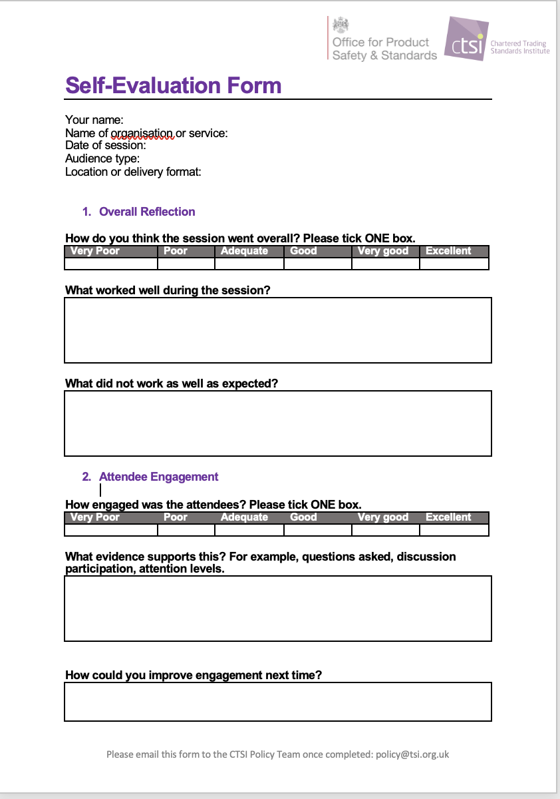
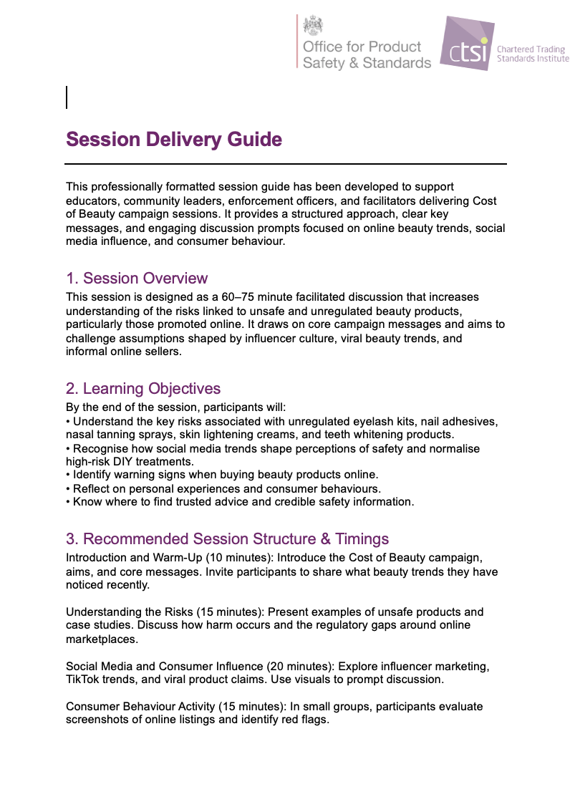
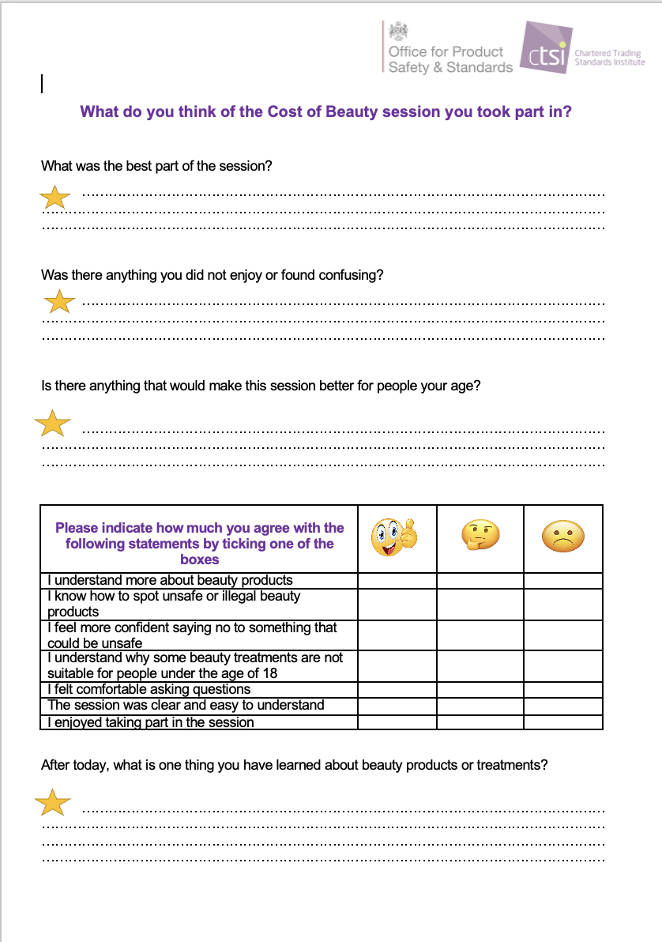

Evaluation and Feedback
The ‘Partner Guidance’ folder includes a set of optional feedback and self evaluation forms. These forms are designed to support delivery of Cost of Beauty sessions and to help capture learning, engagement, and practical feedback from participants and presenters. They include:
Participant feedback forms for under 18s and adults
A presenter self evaluation form to be completed after delivery
Customizable blank feedback form
Use of these forms is encouraged but not required. Partners are welcome to adapt, amend, or simplify the forms to suit their audience, setting, or delivery style. The wording, format, and level of detail can be changed where helpful.
Any completed presenter self evaluation forms can be shared with CTSI by emailing them to policy@tsi.org.uk to support ongoing development of the Cost of Beauty toolkit and resources.
Partner Guidance

Slide 6

Resource Directory
This toolkit should be used alongside trusted external resources that provide further guidance and up to date information. Below are trusted sources we advise you use:
• Cosmetic, Toiletry and Perfumery Association (CTPA)
Industry guidance on cosmetic safety, ingredients, labelling and compliance.
https://www.ctpa.org.uk
• Office for Product Safety and Standards (OPSS)
UK government guidance on cosmetic product safety and legal requirements.
https://www.gov.uk/guidance/making-cosmetic-products-available-to-consumers-in-great-britain
• Business Companion
Clear, practical guidance on cosmetic product law for businesses and consumers.
https://www.businesscompanion.info/en/quick-guides/product-safety/cosmetic-products
• The Facts About
Independent consumer safety information supported by Trading Standards.
https://www.thefactsabout.co.uk
• UK Government Product Safety Guidance
General advice on product safety and consumer rights.
https://www.gov.uk/consumer-protection-rights
• Scientific Committee on Consumer Safety (SCCS)
Scientific opinions on the safety of cosmetic ingredients used in the UK and EU.
https://health.ec.europa.eu/scientific-committees/scientific-committee-consumer-safety-sccs_en

Slide 7
Thank you!
For additional guidance and questions, please contact the CTSI Policy Team at: policy@tsi.org.uk

