Slide 1
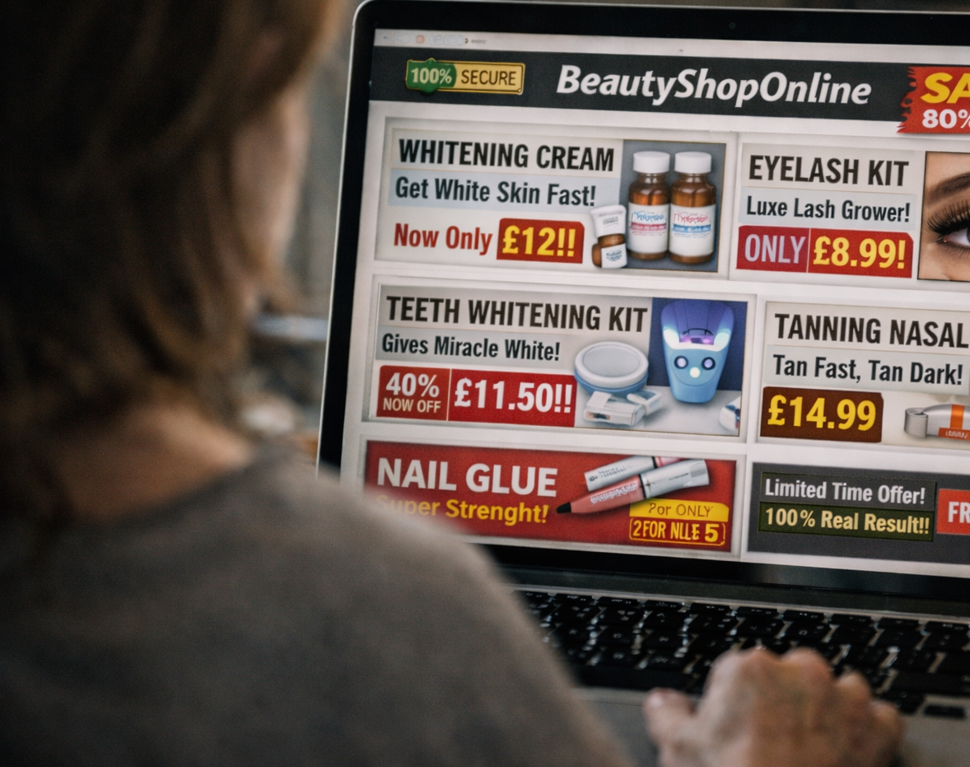
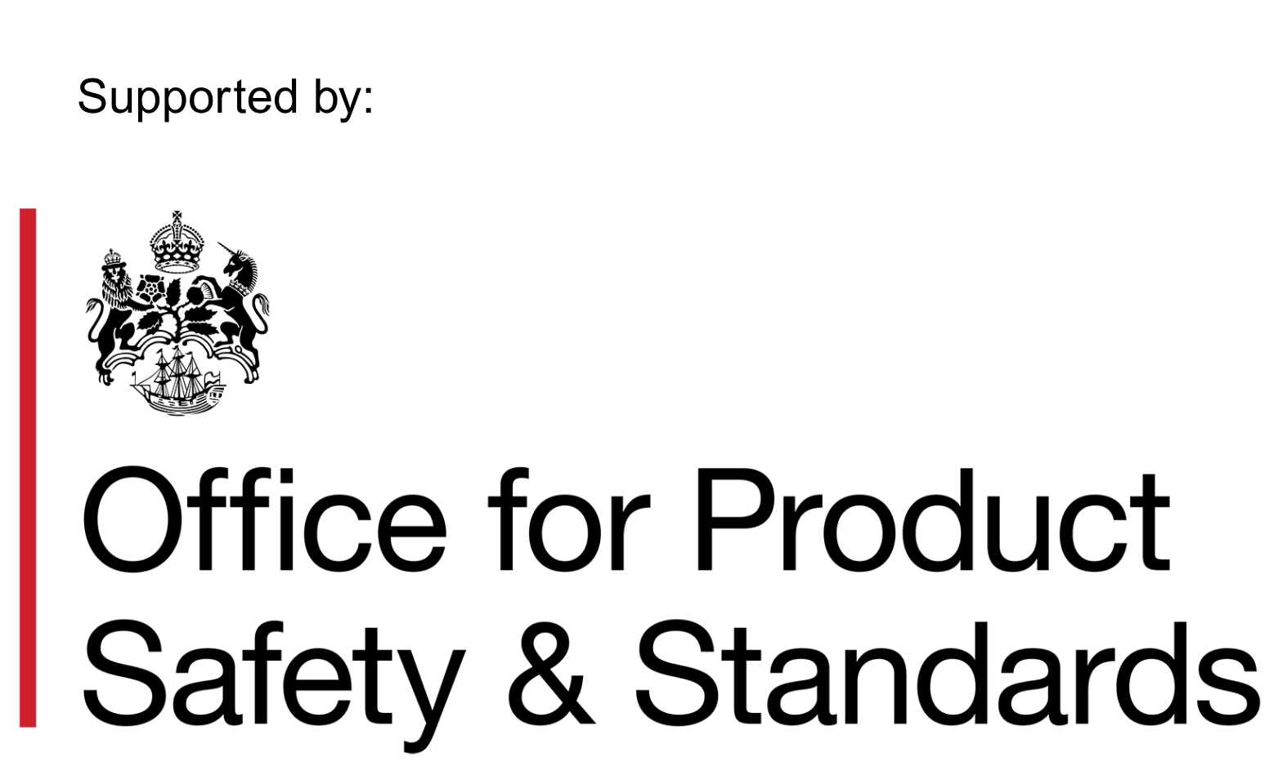

Chartered Trading
Standards Institute
Cost of Beauty Toolkit: Consumer Factsheets Guidance

Slide 2


Core Educational Material

Slide 3
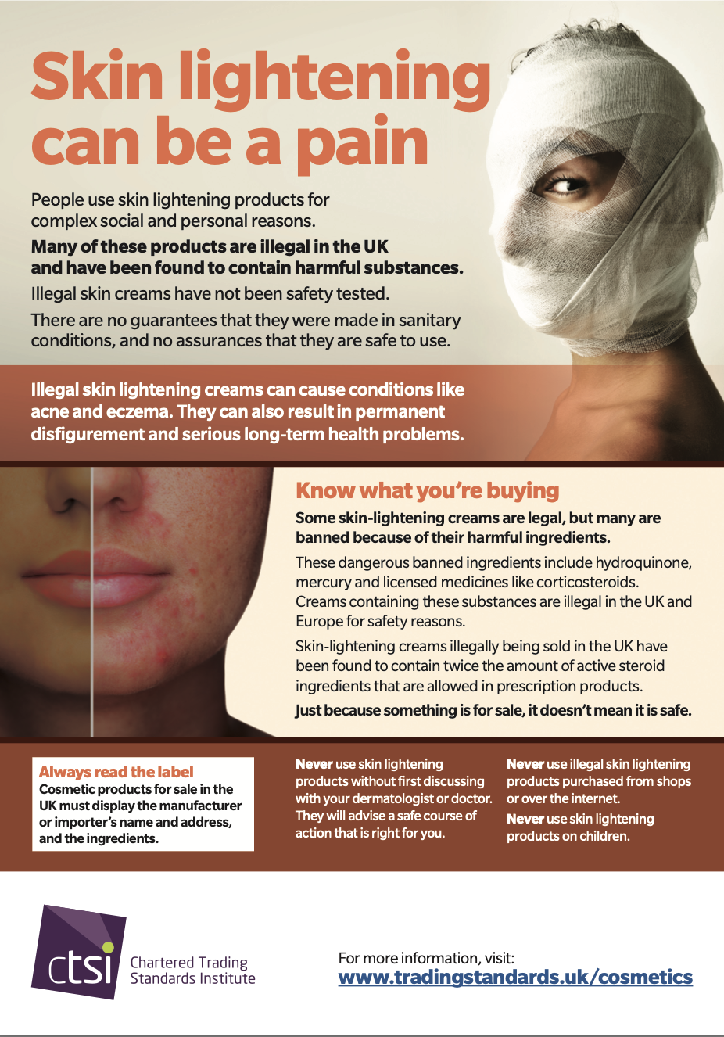
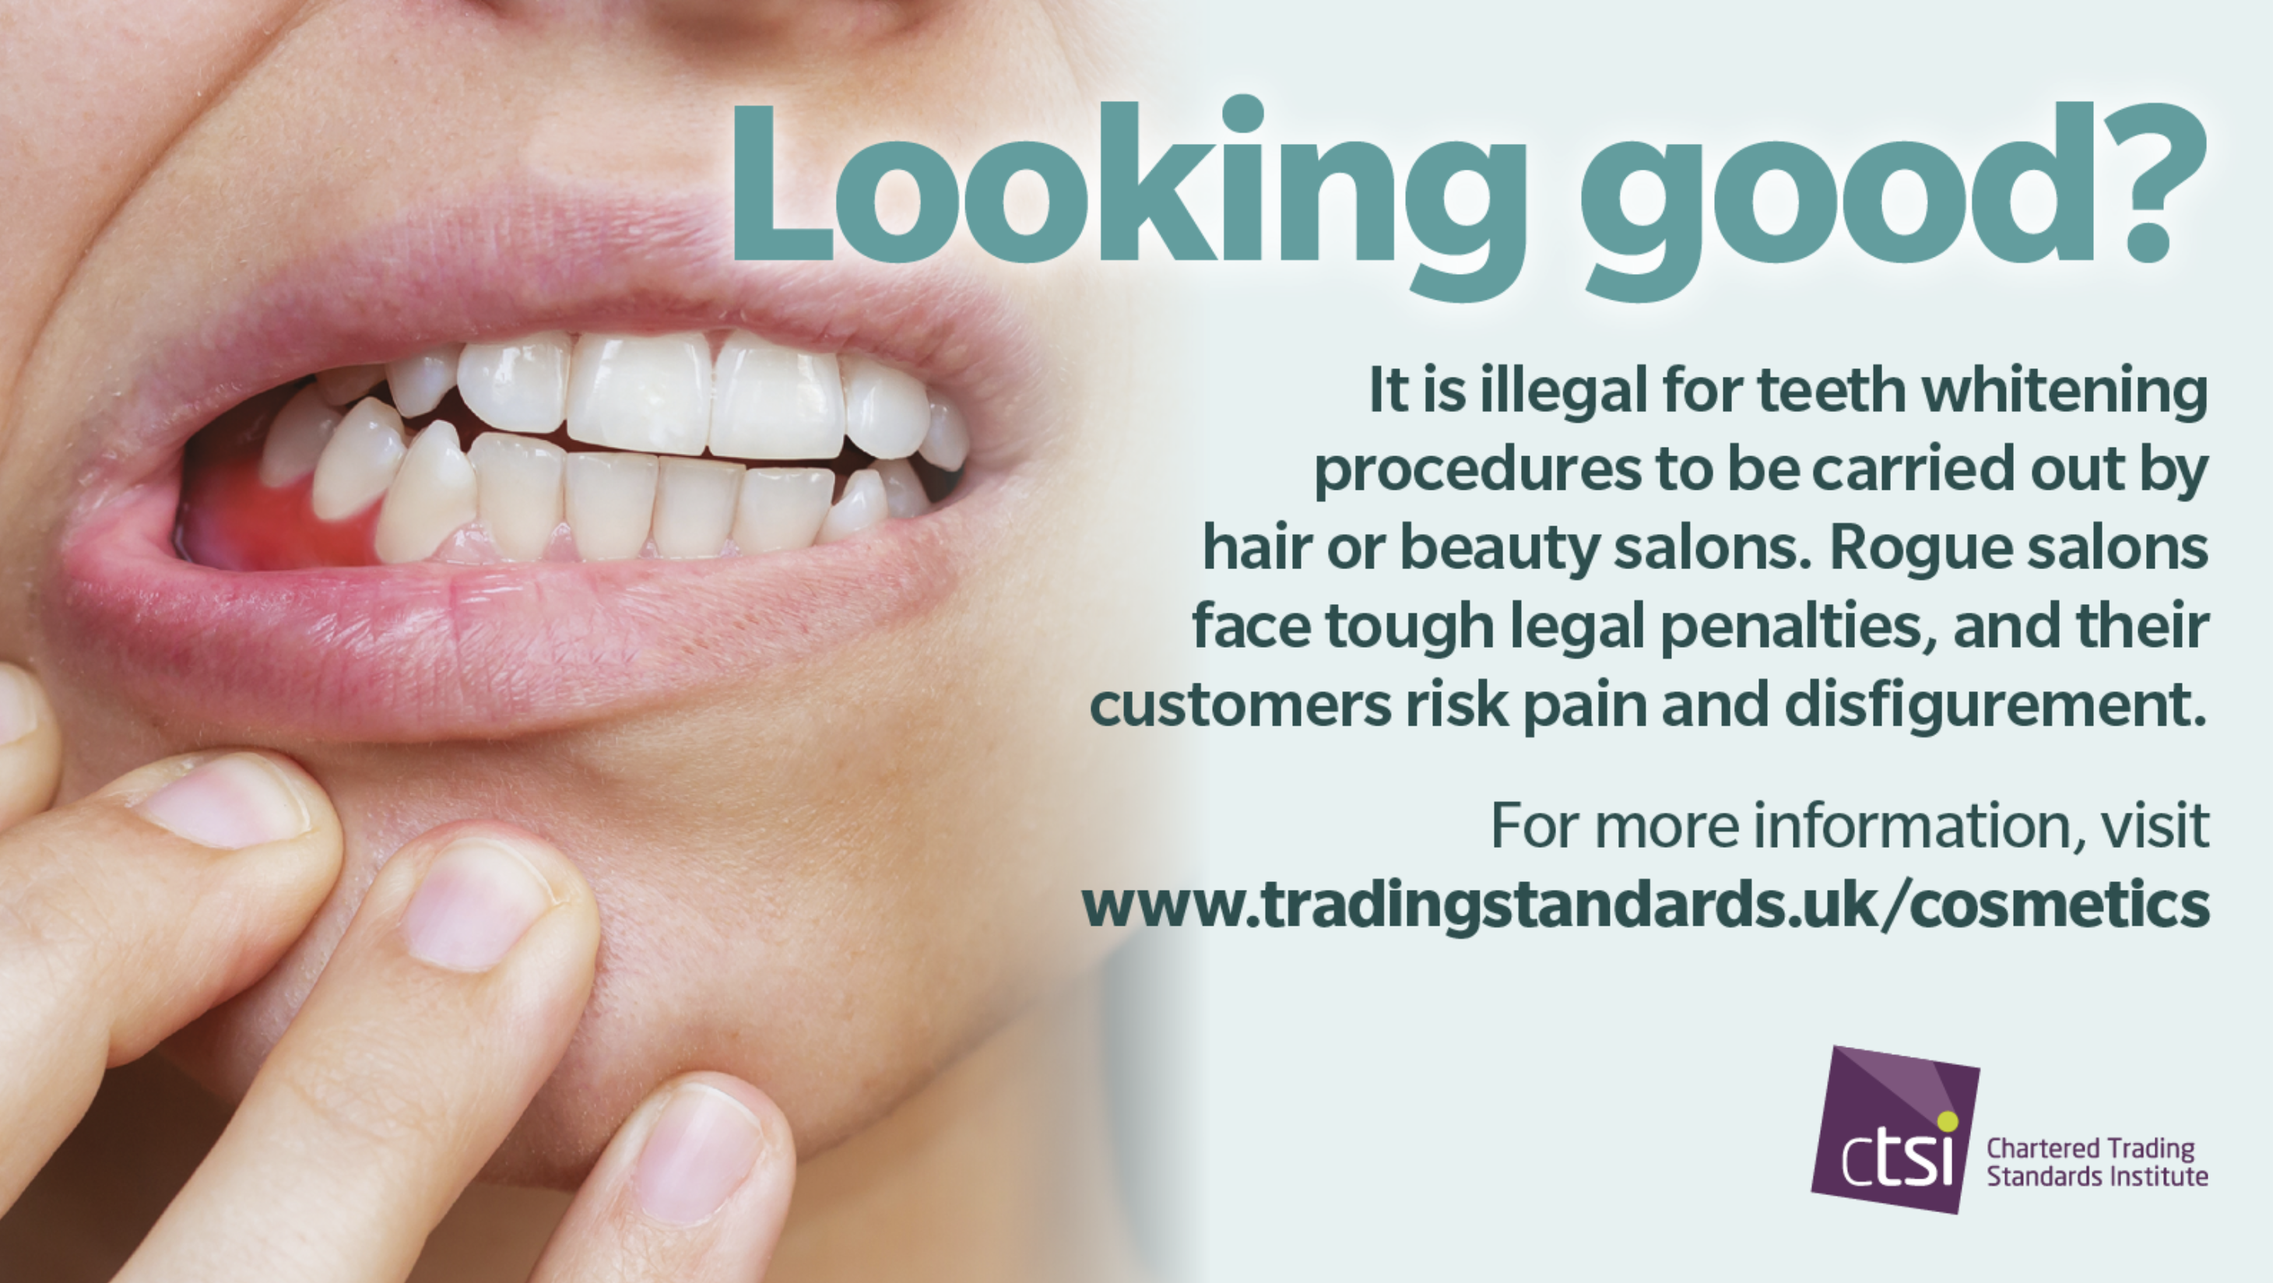
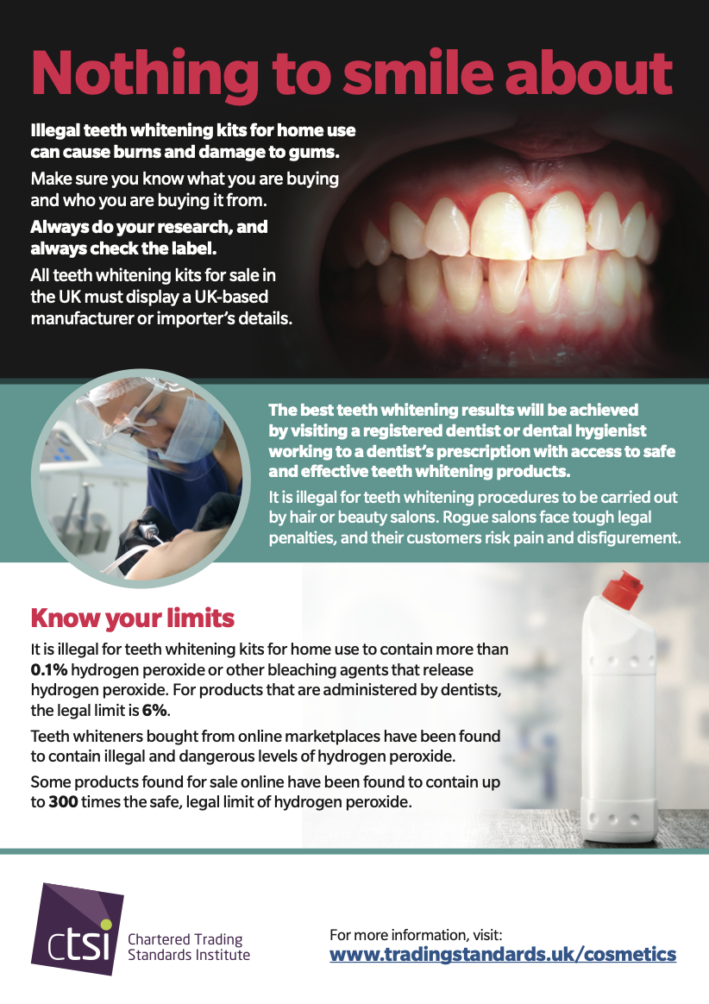
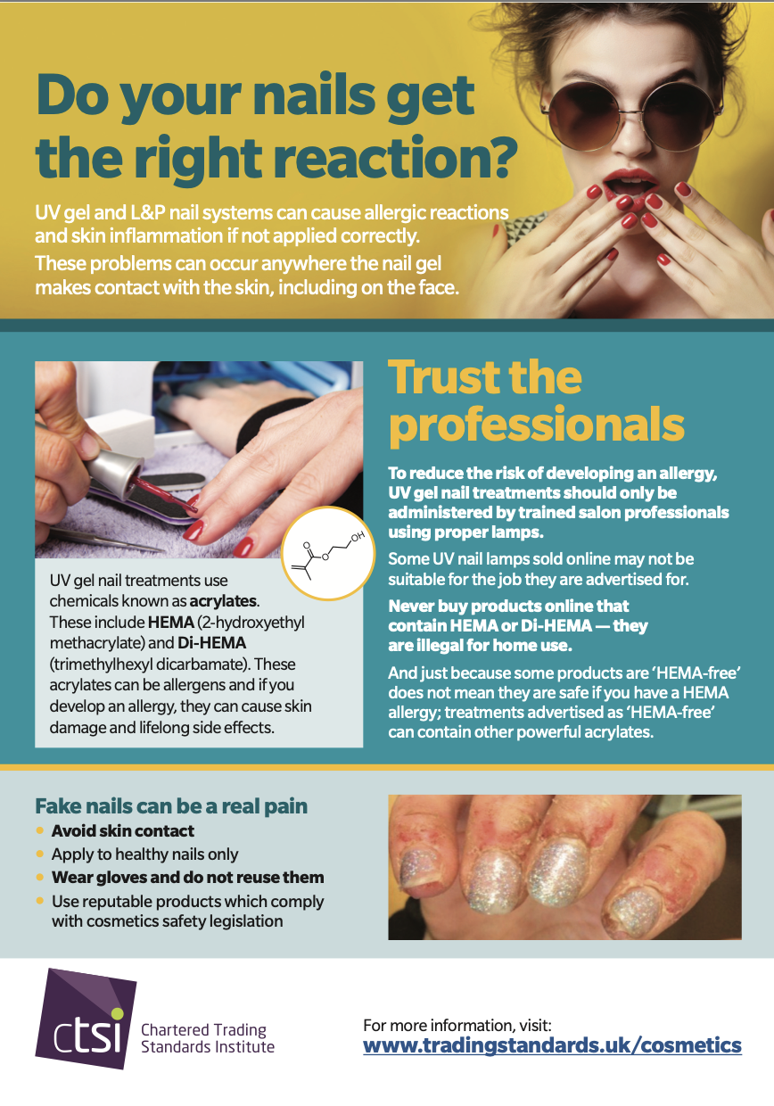
Core Educational Material
This toolkit contains a set of core educational resources that can be used together or independently depending on the audience and setting.
The materials are designed to support structured sessions, informal discussions and awareness raising activities.
They include detailed factsheets, myth busting content and clear answers to common consumer questions.
All of our educational materials are available in Welsh, Arabic, Punjabi and Urdu, recognising that some products, particularly skin lightening products, are more commonly marketed to and used within certain Black, Asian and minority ethnic communities, and that clear information needs to be accessible in the languages people use.
You can find these resources in the ‘Consumer Factsheets’ folder.

Slide 4
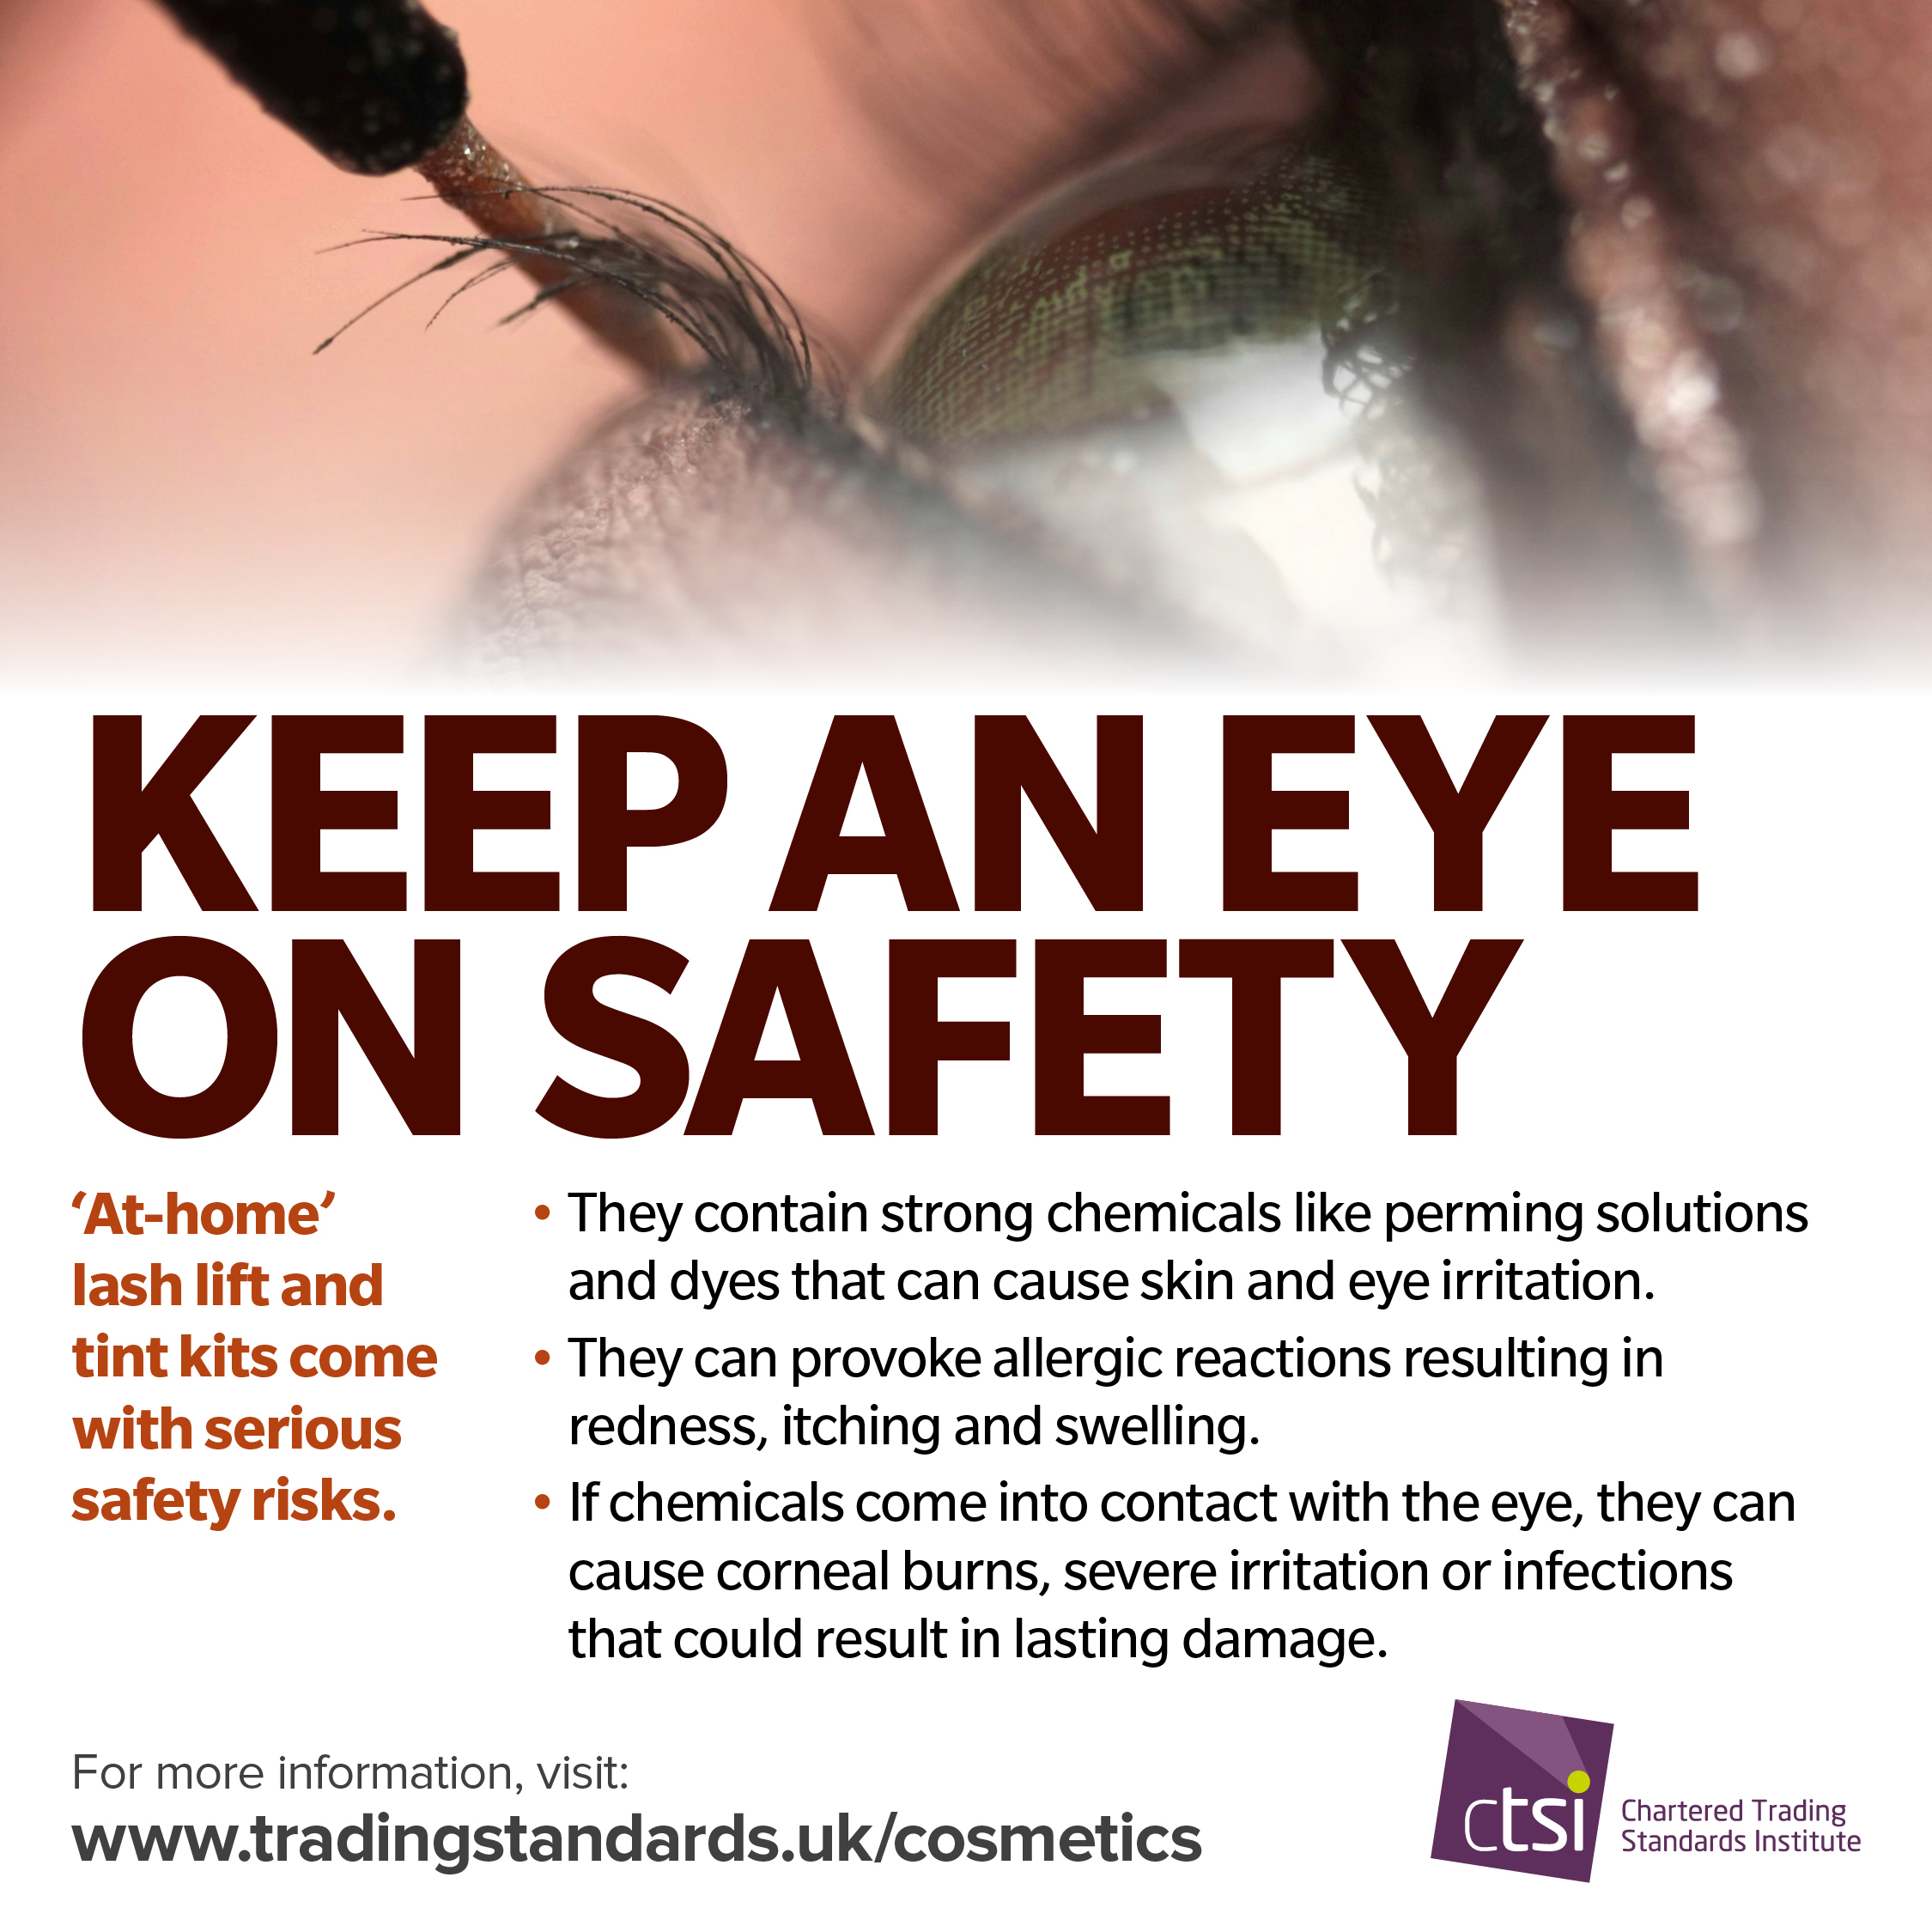
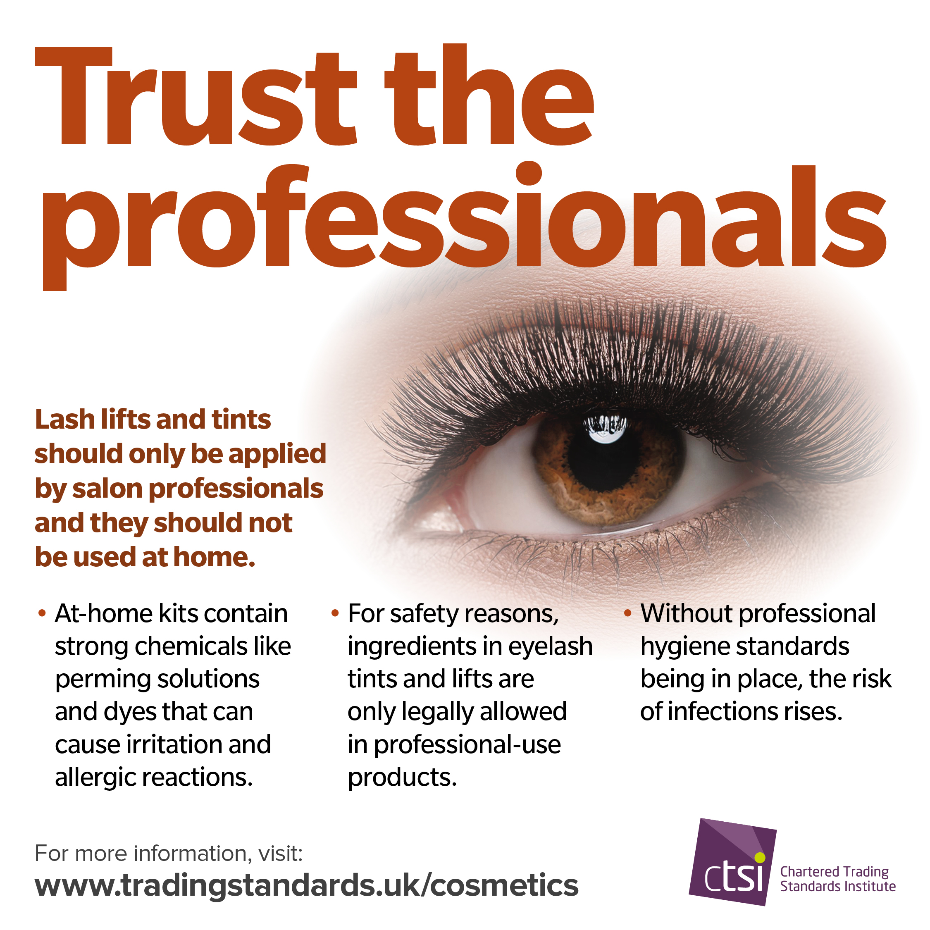
Focus 1: Eyelash Lift Kits
Eyelash lift kits often contain strong chemical solutions designed for professional use. When used incorrectly or without training, these chemicals can cause burns to the eyelids and eyes, permanent eye damage and severe irritation. Many kits sold online lack proper instructions, safety warnings or accurate ingredient lists, increasing the risk of harm.

Slide 5
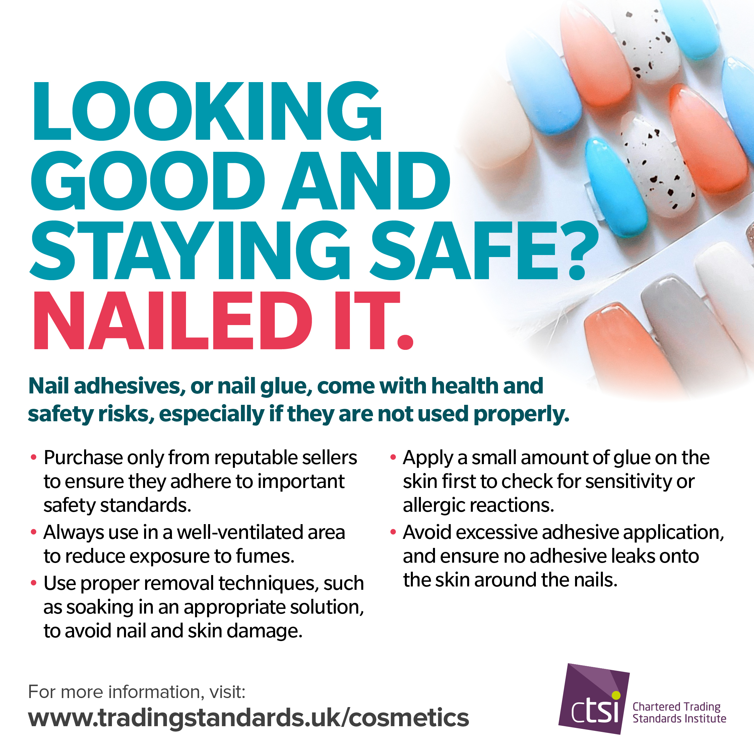
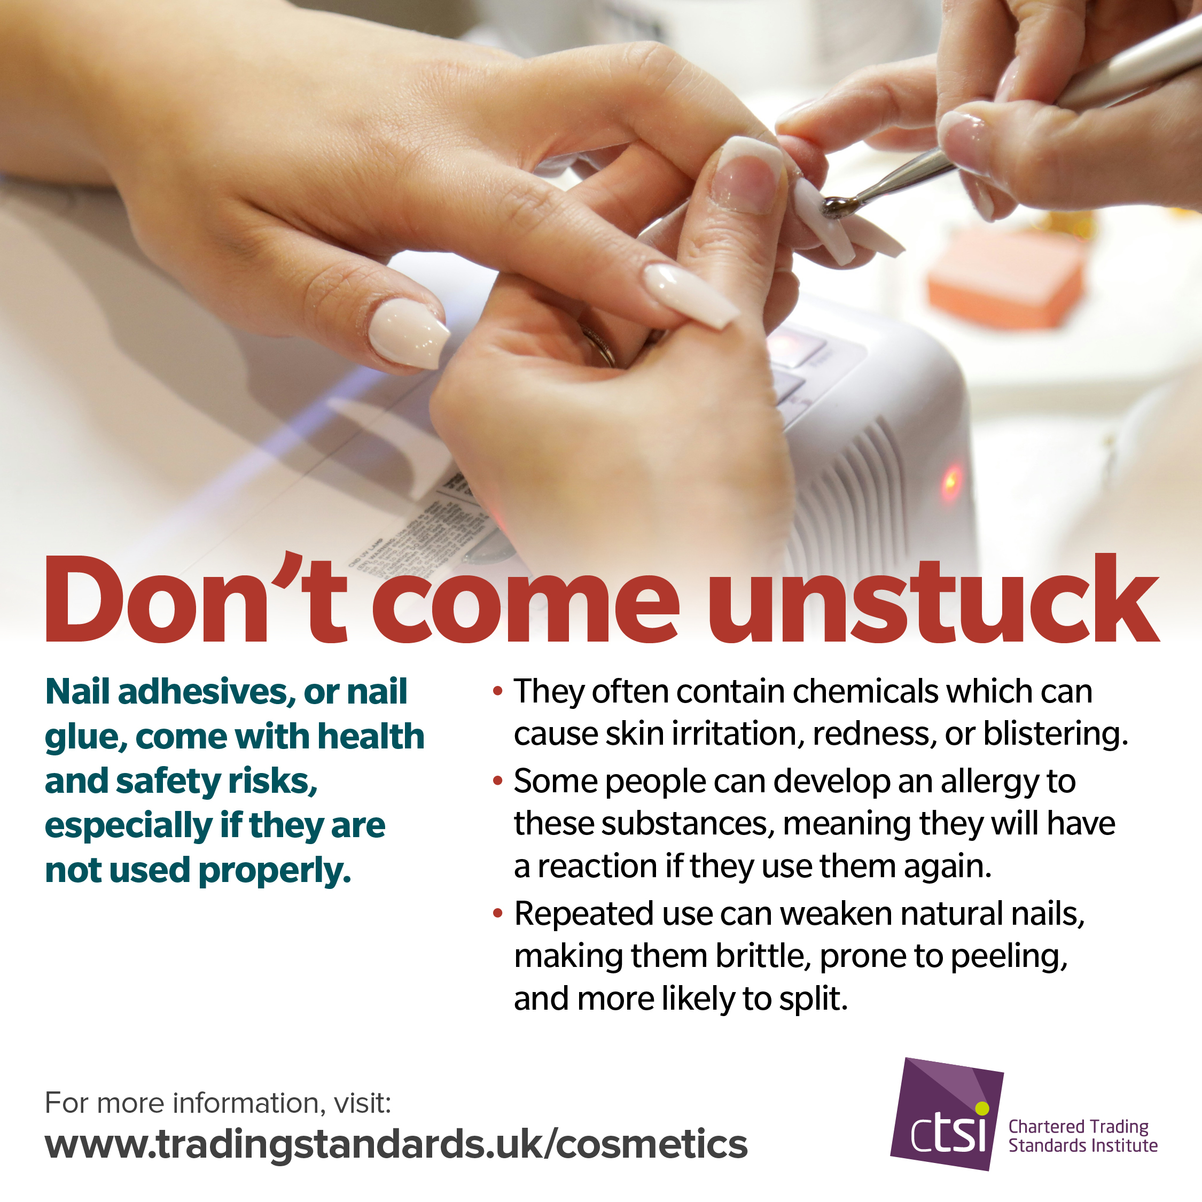
Focus 2: Nail Adhesives
Some nail adhesives sold for home use contain super strength glues similar to industrial products. These can bond skin instantly, cause burns and trigger allergic reactions.
Injuries often occur when consumers attempt to remove false nails without understanding the risks or correct techniques.

Slide 6
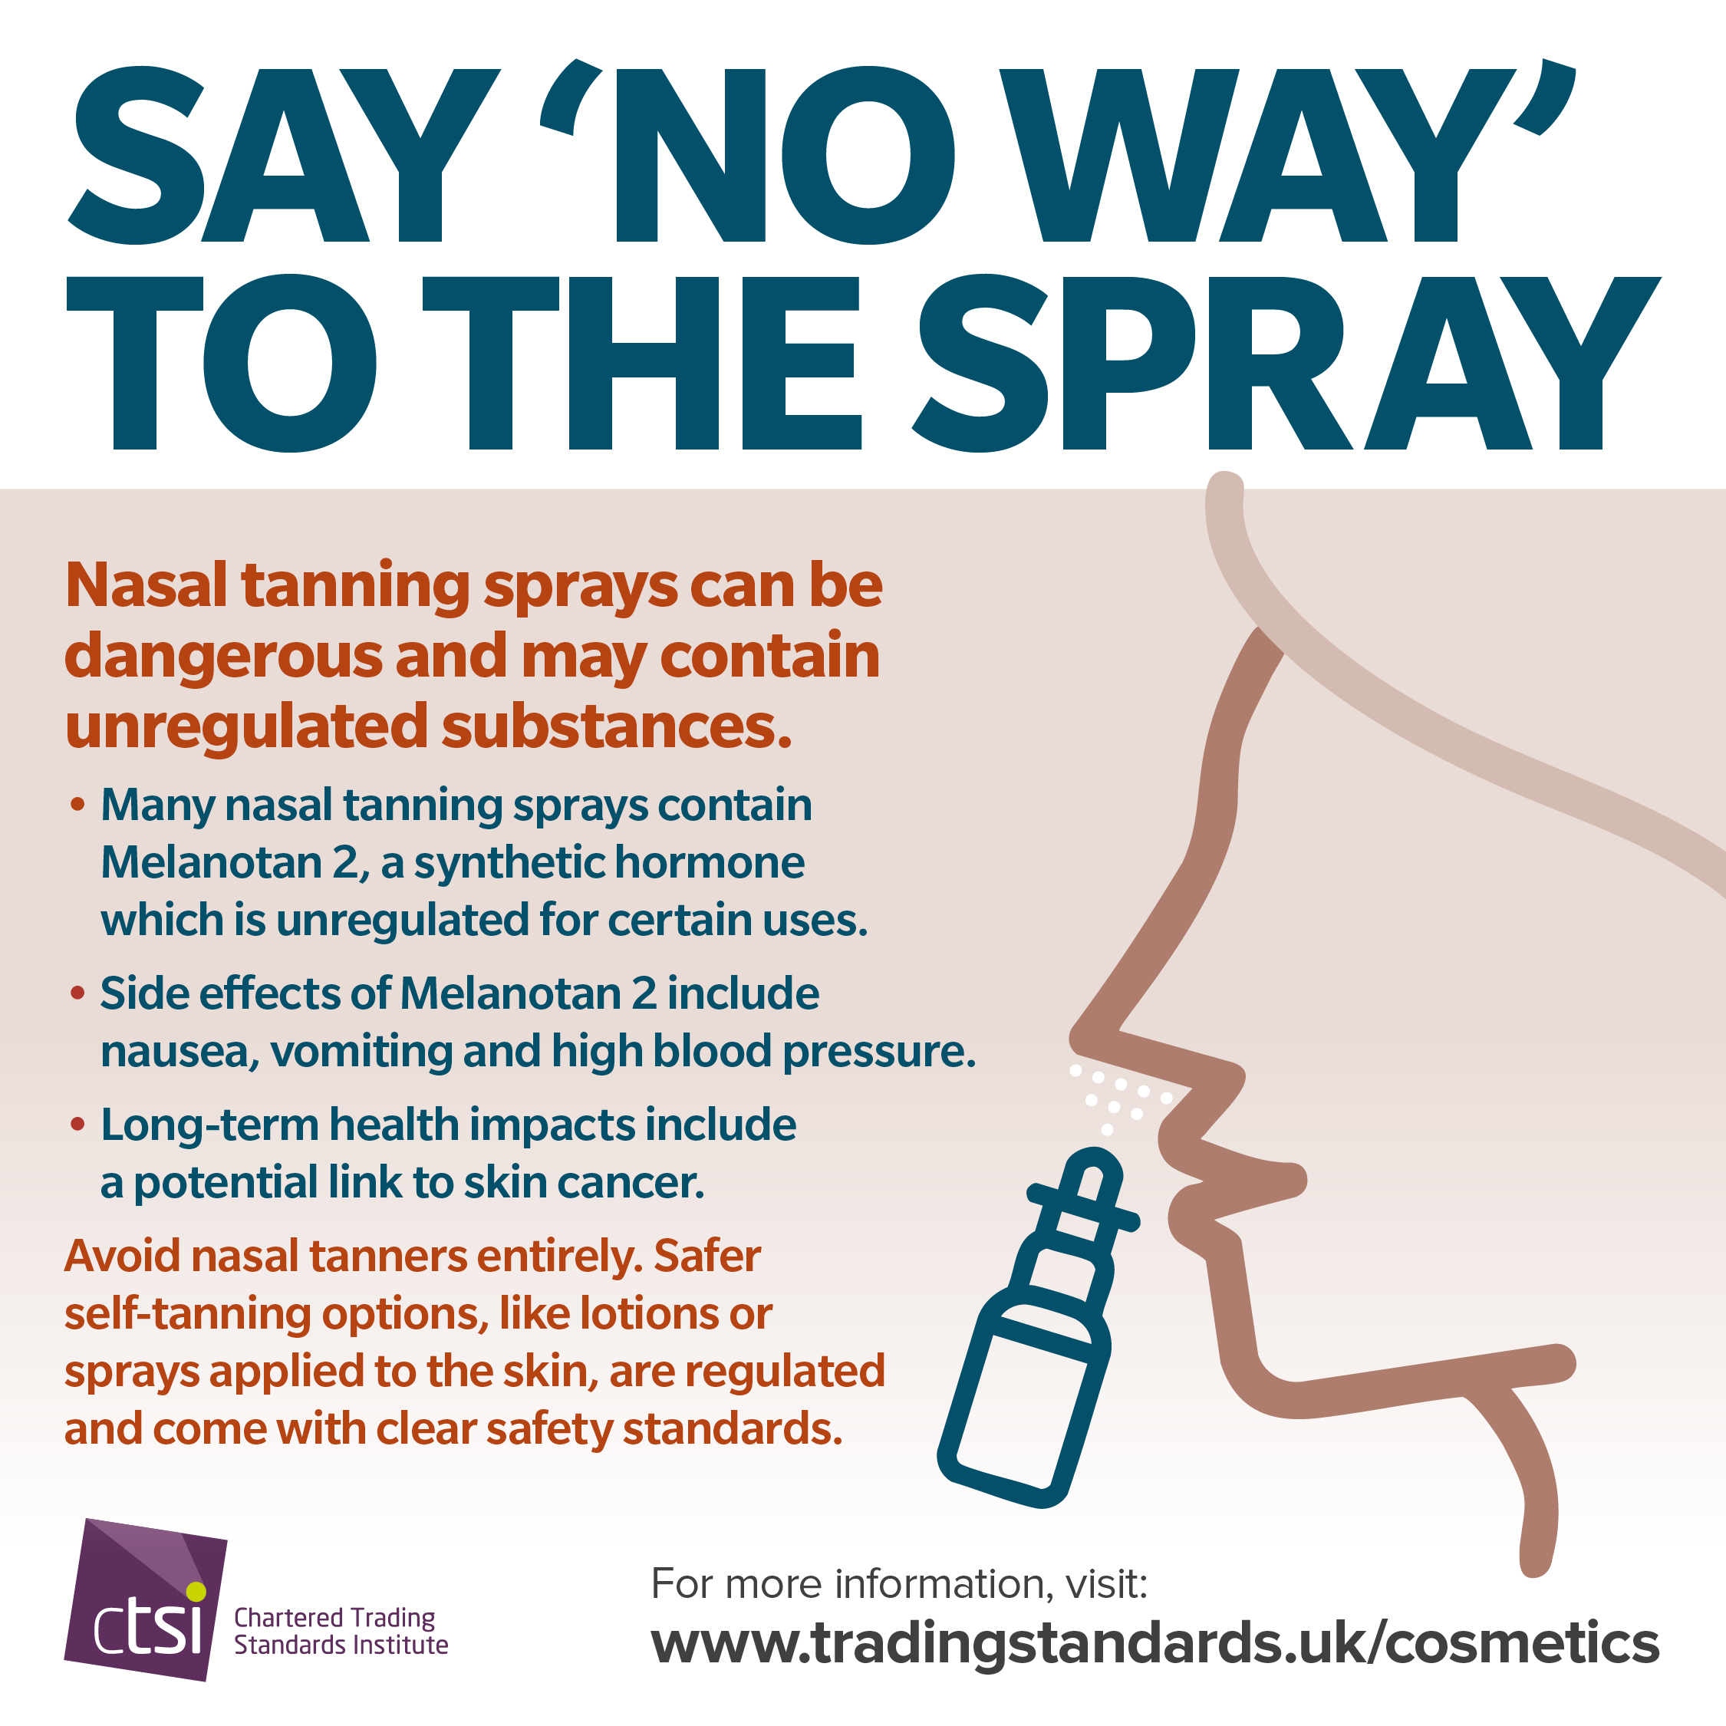
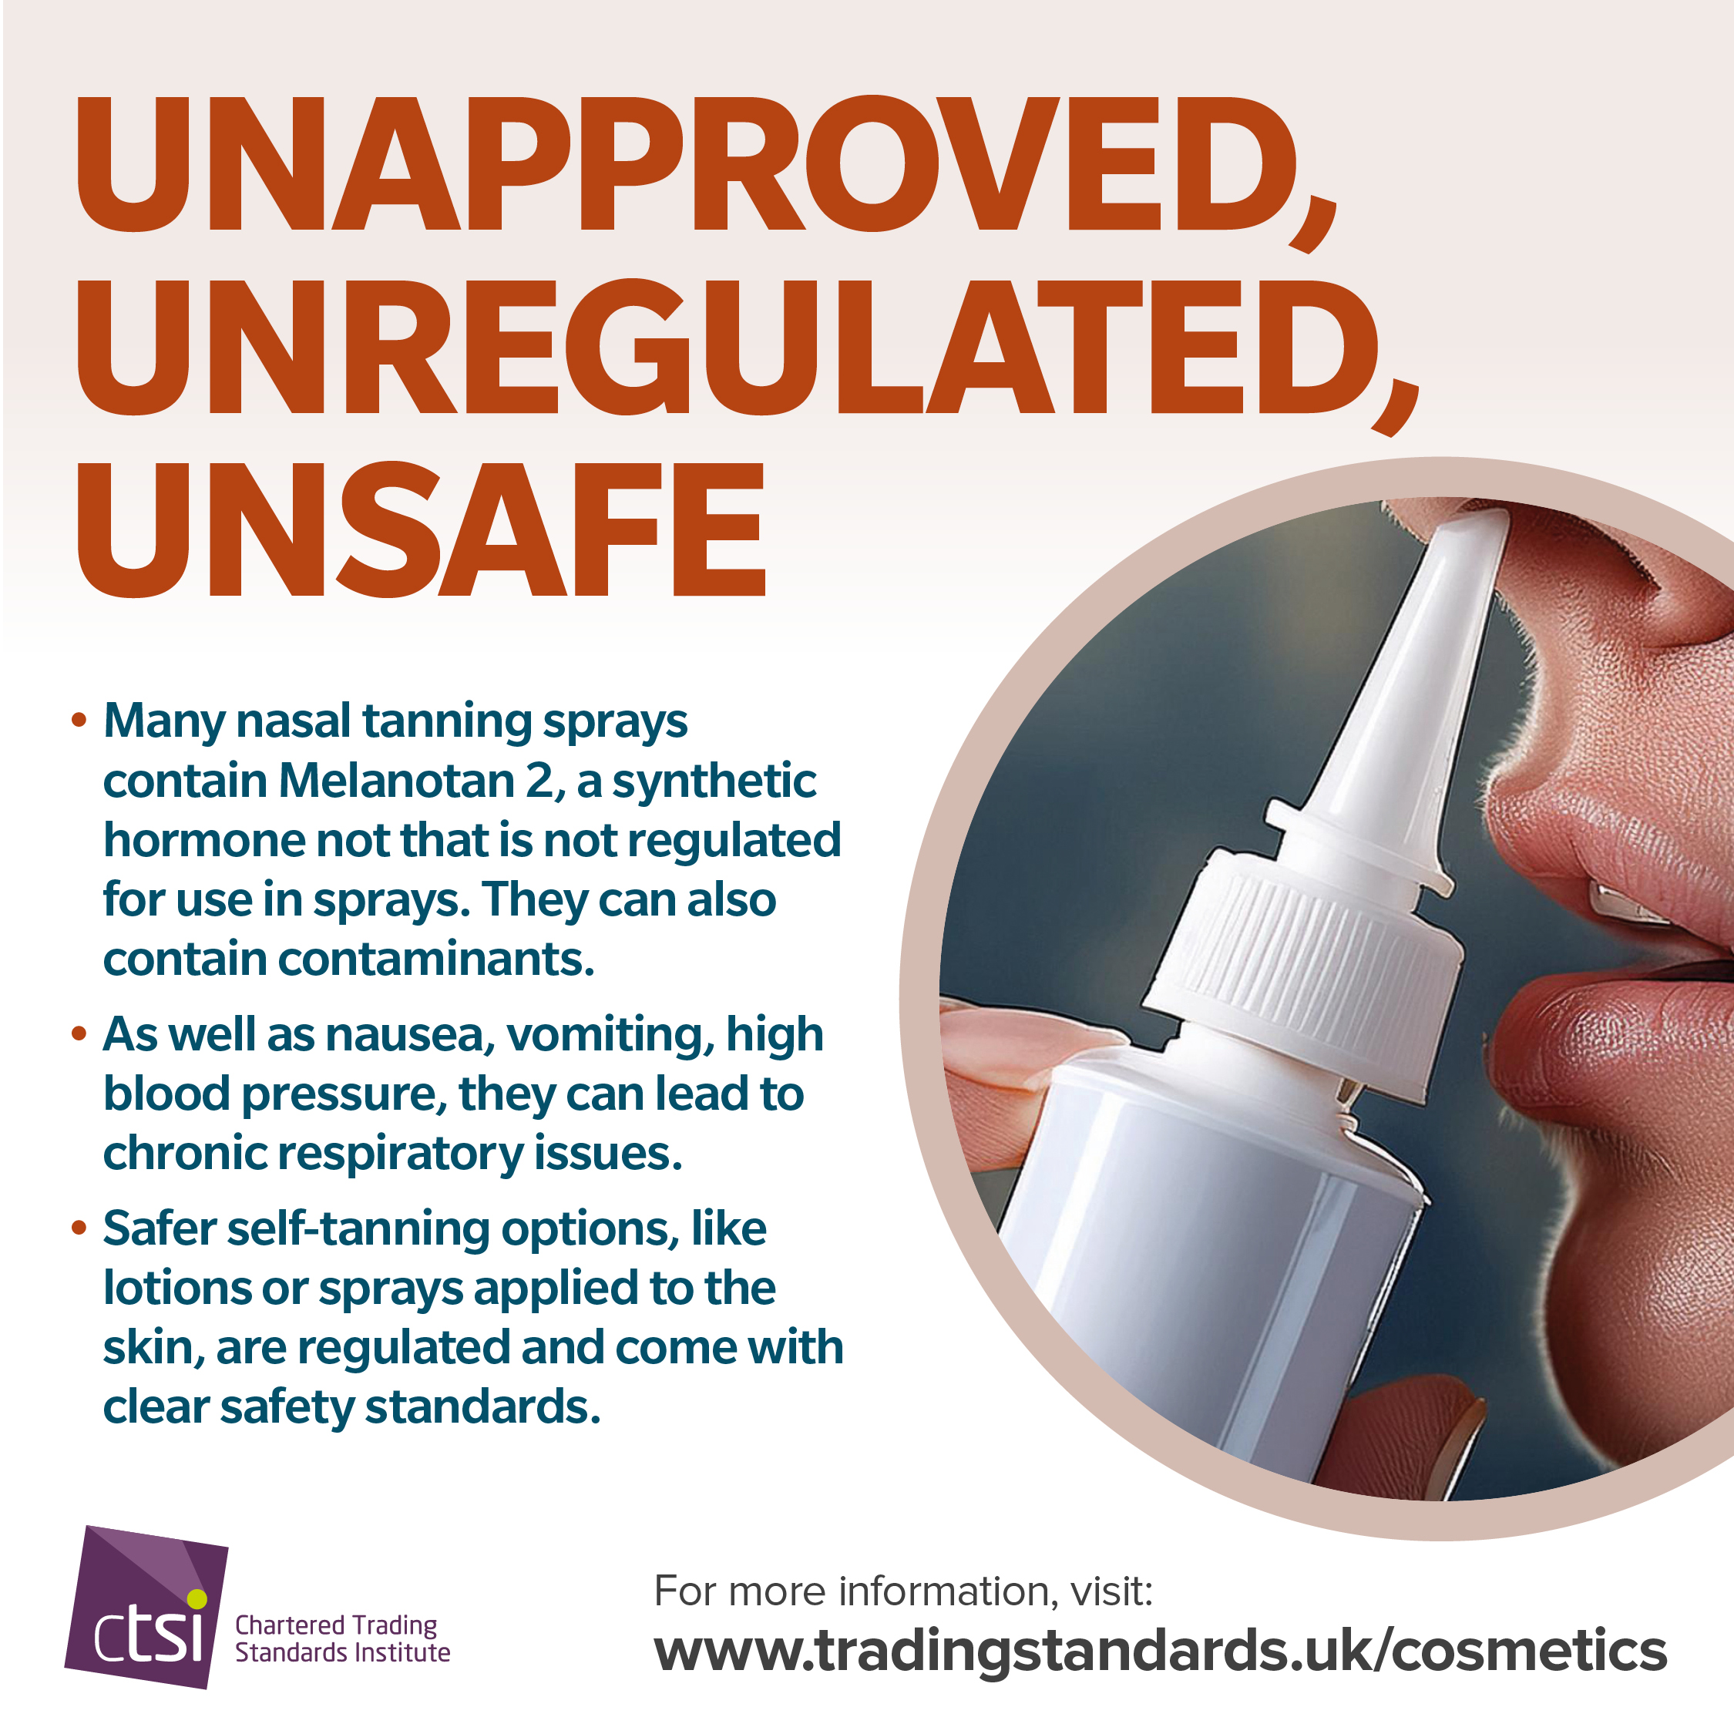
Focus 3: Nasal Tanning Sprays
Nasal tanning sprays are not authorised cosmetic products in the UK. They are inhaled directly into the body and may contain unapproved or unknown substances. Use of these products can irritate the airways and carry wider health risks that are not fully understood.

Slide 7
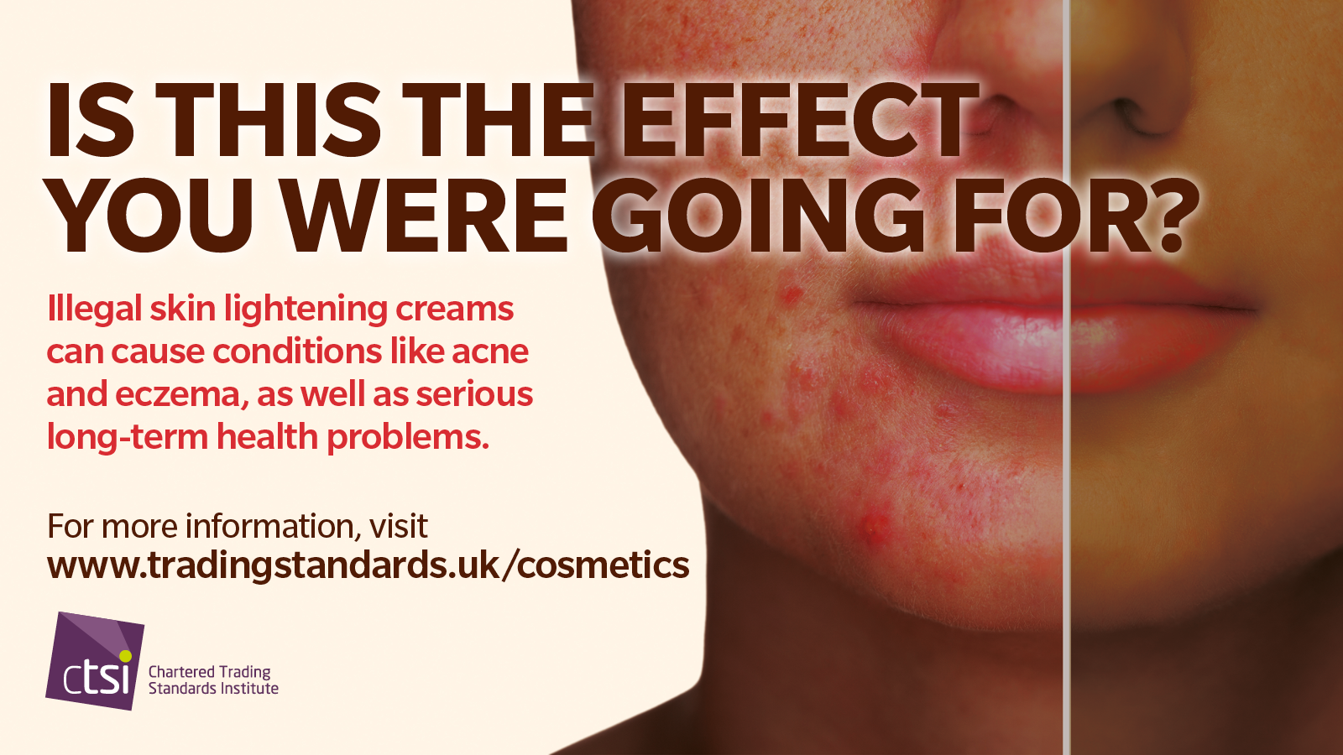
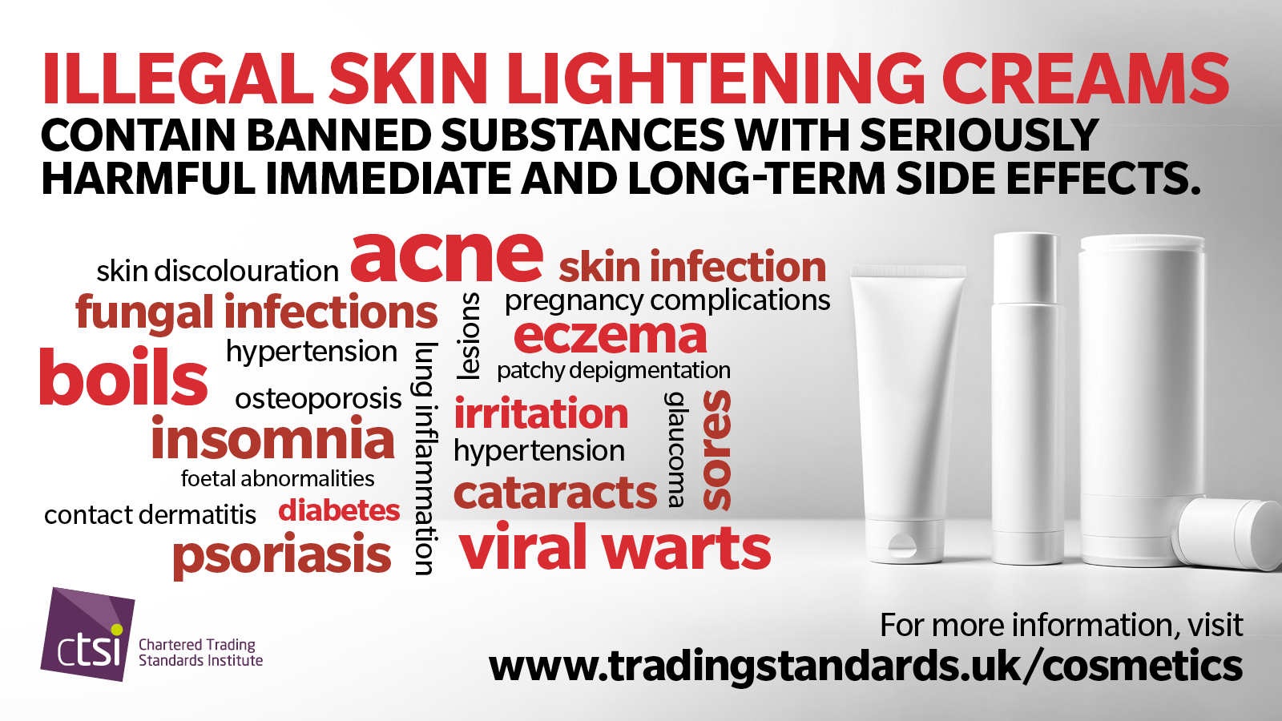
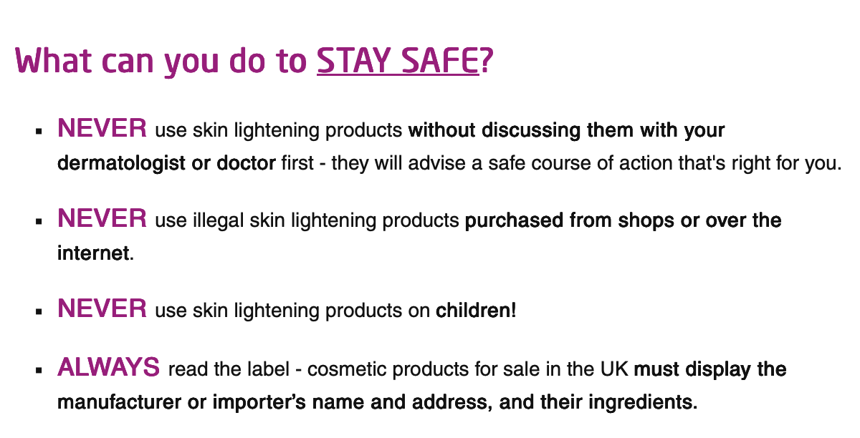
Focus 4: Skin Lightening Products
Skin lightening creams are frequently found to contain illegal ingredients such as mercury or high strength steroids. These substances can damage the skin, disrupt hormone function and cause longer term health problems. Products are often poorly labelled or falsely marketed, making it difficult for consumers to identify the risks.

Slide 8

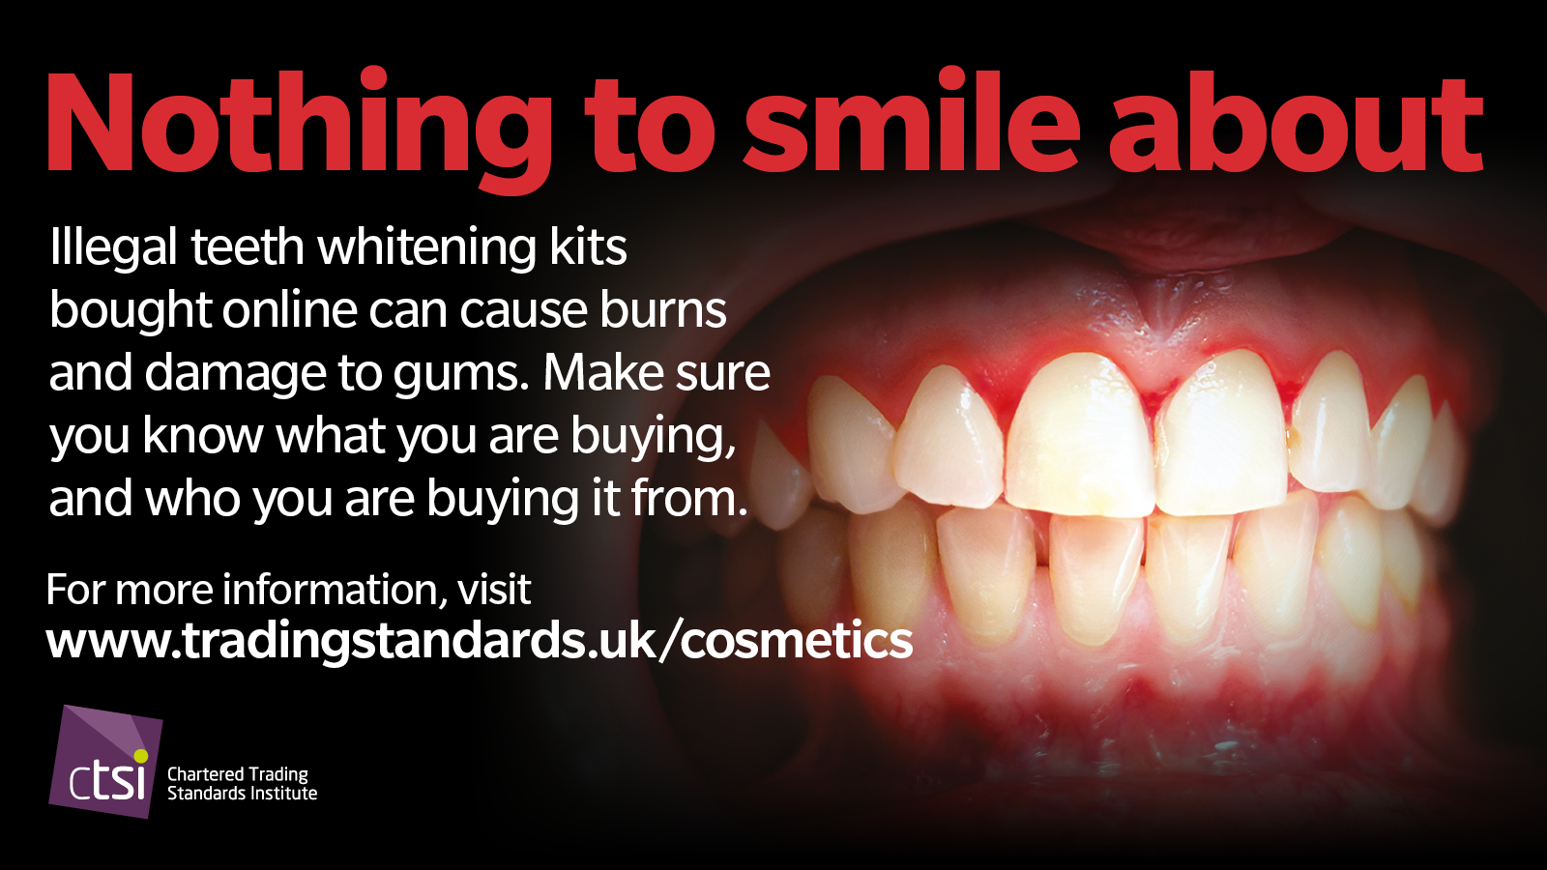
Focus 5: Teeth Whitening
Illegal teeth whitening kits for home use can cause burns and damage to gums. Make sure you know what you are buying - and who you are buying from. Always do your research, and always check the label. All teeth whitening kits for sale in the UK must display a UK-based manufacturer or importer’s details.
However, the best teeth whitening results will be achieved by visiting a registered dentist or dental hygienist working to a dentist’s prescription - with access to safe and effective teeth whitening products.

Slide 9
Risk Area | Common Hazard | Safe Practice
Eyelash Lift Kits | Chemical burns, eye infections | Use only in salons by trained professionals
Nail Adhesives | Skin burns, allergic reactions | Purchase from reputable sources; avoid DIY kits
Nasal Tanning Sprays | Unapproved chemicals, systemic risks | Avoid entirely; opt for safe tanning alternatives
Skin-Lightening Creams | Banned ingredients, severe skin damage | Check legality and ingredient compliance
Teeth Whitening Kits | Excess hydrogen peroxide causing burns | Seek professional dental treatment only

Slide 10
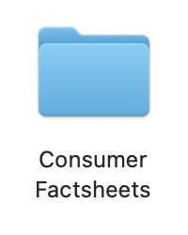
Downloadable Assets
All core educational material can be found and downloaded in the ‘Consumer Factsheets’ folder within the toolkit.

Slide 11
Thank you!
For additional guidance and questions, please contact the CTSI Policy Team at: policy@tsi.org.uk

